Slide 1
Important!
This session is being recorded and your contributions may be captured and shared online.
This is a short express session so audio and video for participants has been disabled for the main room.
Please hold onto your questions and email our support team DFT@westernsydney.edu.au if not answered.
Notes:
This will be the introduction page.

Slide 2
vUWS Express
Bb Collaborate Ultra & Breakout Rooms

Slide 3
Welcome!
Overview
Setting up rooms
Assigning participants
Comms across rooms
Roles and promotion

Slide 4
Overview
Purpose
The main use case is that students are broken into groups of students that discusses a shared or unique problem statement, and then returns to the main room.
One student is then promoted to a presenter to present their findings.
General
Breakout rooms have their own private audio, video, whiteboard, app sharing and chat.
Moderators can create up to 20 break-out rooms.
Participants become Presenters automatically in Breakout Rooms

Slide 5
Moderators can:
Randomly or Manually assign participants to rooms
Allow participants to change groups as needed
Jump in/out of rooms as needed
Share files with all rooms
Share chat with all rooms
Share timer with all rooms (currently disabled due to Covid-19)

Slide 6
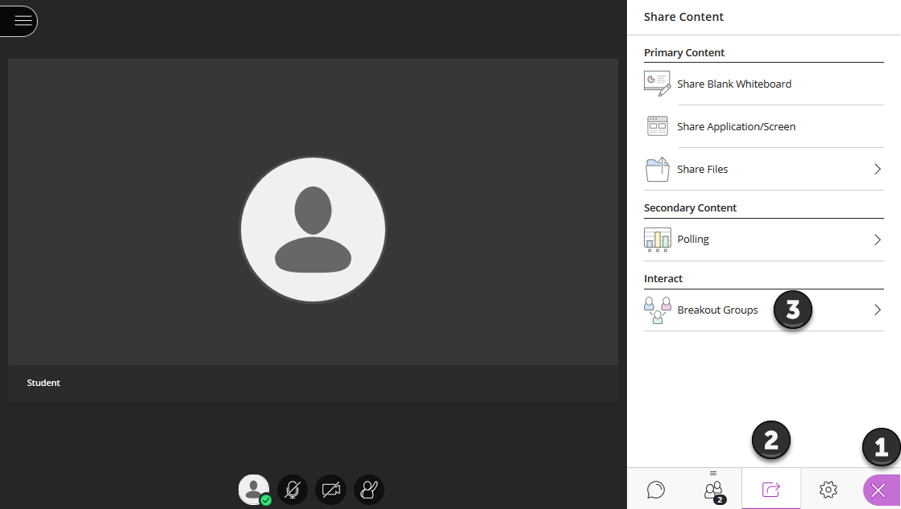

Slide 7
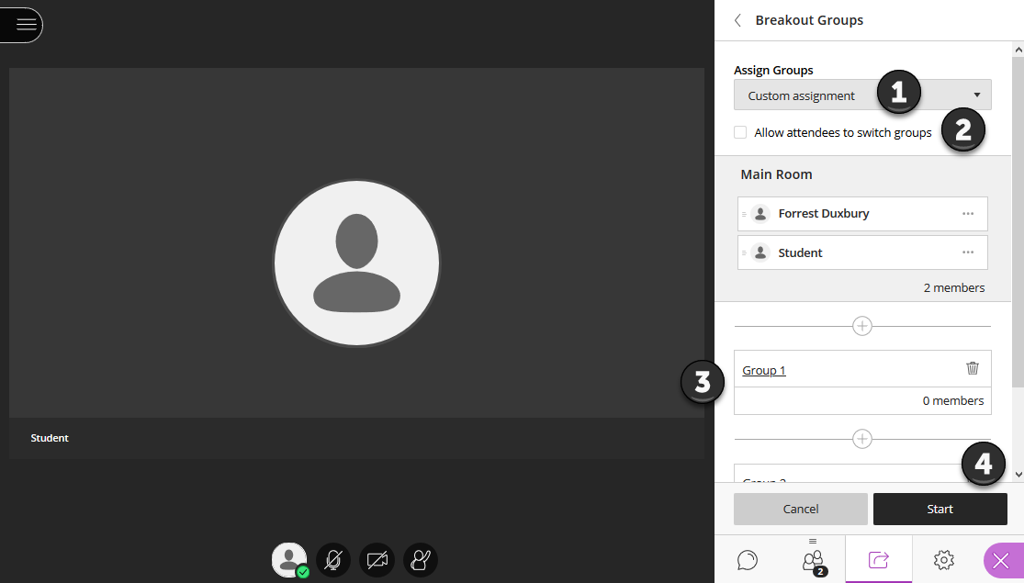

Slide 8
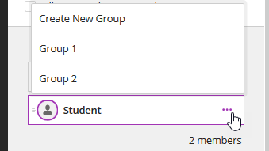
Manual Allocation
Hold down shift to drag and drop multiple students!

Slide 9
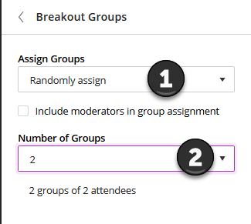
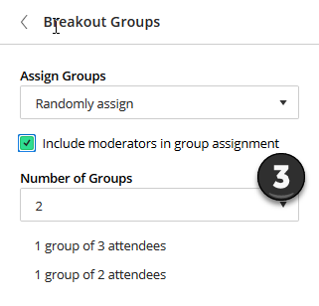
Random Allocation

Slide 10
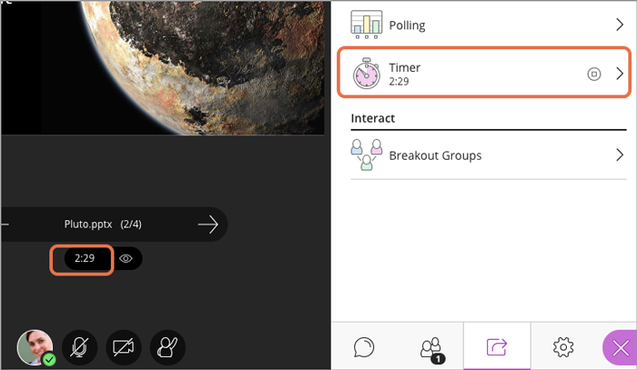
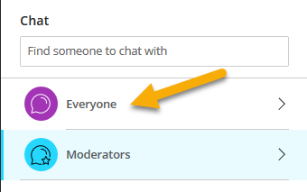
Communication across Rooms
A Timer is normally available – this is temporarily disabled.
Use your own timer – and send updates to all rooms via Chat.

Slide 11
Demonstration
I will create TWO break-out rooms randomly for TWO minutes.
I will send you a image to each group, please discuss using the presenter tools.
I will send you a chat message with remaining time before I pull you back.
I will promote someone to speak on behalf of the group.

Slide 12
Important
Content is lost when breakout rooms are closed.
Save files back? (theoretically possible)
Breakout rooms are not recorded.
Breakout Rooms are not available for >250.

Slide 13
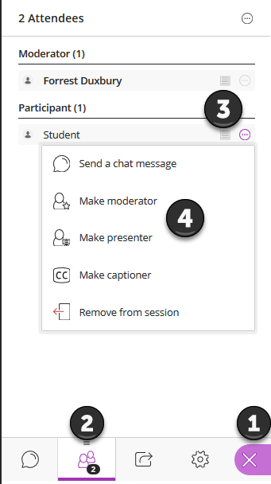
Promoting Participants
Open the Collaborate Panel
Open the Participants Tab
Click the Ellipsis
Click Make moderator/presenter

Slide 14
Roles
vUWS | Bb Collaborate Ultra
Instructor | Moderator
Teaching Assistant | Presenter
Student | Participant

Slide 15
Presenters
Can Do | Cannot DO
Share Audio/video | Change roles
Upload and Share | Moderate Breakout Rooms
Share Apps / Screen | Mute Attendees
Use Whiteboard/Annotation | Record Sessions

Slide 16
Further information
Western Sydney Support Resources
https://dft.westernsydney.edu.au/support/
https://wsu.service-now.com/it
New Learning Futures Resources
Virtual Classroom Comparison Matrix
Bb Collaborate Ultra – Features
Blackboard Resources
Blackboard Collaborate Ultra – Moderator Support
Blackboard Collaborate Ultra – Student Support

Slide 17
Further information (2)
Video of Breakout Rooms in Use - https://youtu.be/D4dudLGevhw
Need help?
Contact Us – dft@westernsydney.edu.au
Contact IT – itservicedesk@westernsydney.edu.au

