Slide 1
Important!
This session is being recorded and your chat contributions may be captured.
Audio and video for participants has been disabled, please ask any simple questions in the chat, and our secondary facilitator will answer or capture what they can.
Alternatively, please send questions to DFT@westernsydney.edu.au for our support team to respond to.

Slide 2

Using
Bb Collaborate Ultra
Presented by Forrest Duxbury (LF)

Slide 3
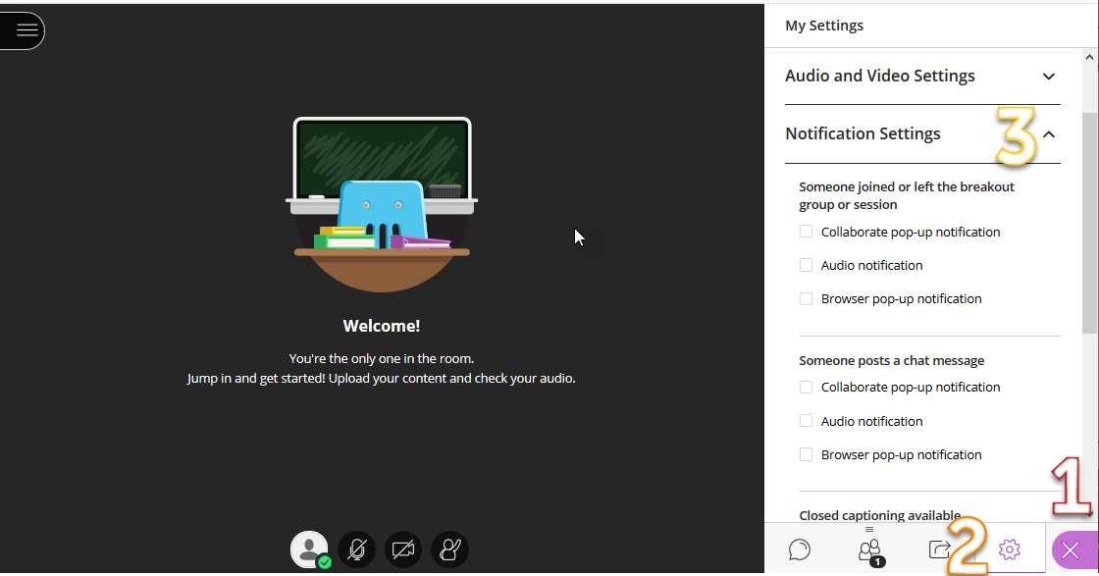
Turning off Notifications

Slide 4
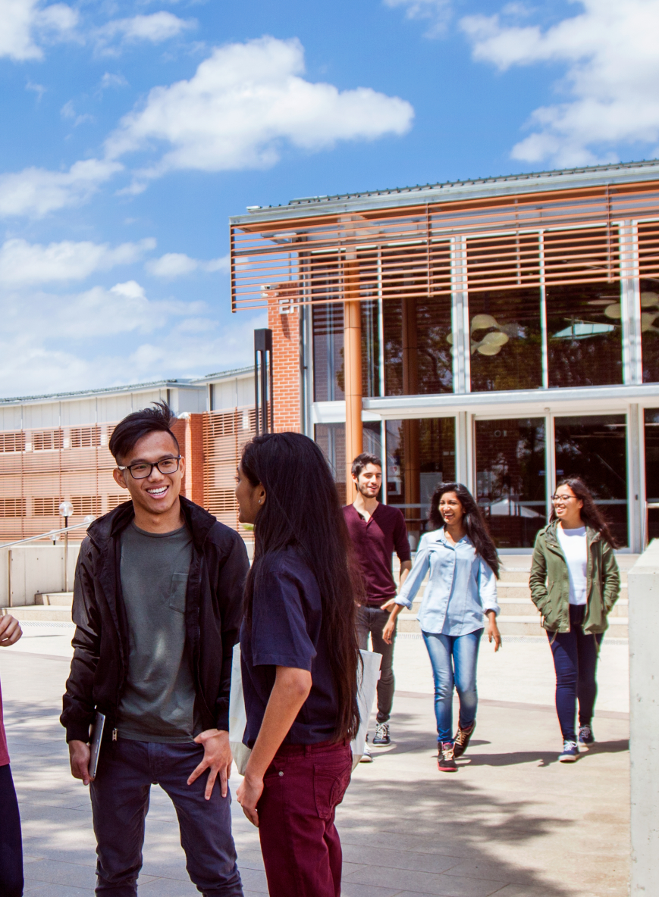
Welcome!
Introduction
Sign-in sheet
Technical issues
Recordings
Questions

Slide 5

What we are covering
General Knowledge
What is Bb Collaborate Ultra?
How does it compare with Zoom?
What do participants need to access it?
How do I get started?
Features
  Whiteboard and Annotation
  Polling
Sharing Screen, Applications and Files
Recording, and Reporting – Attendance
What we are not?
Breakout Rooms, Timers and Student Presenters
What’s next?

Slide 6
But wait –
lets hear from you?

Slide 7
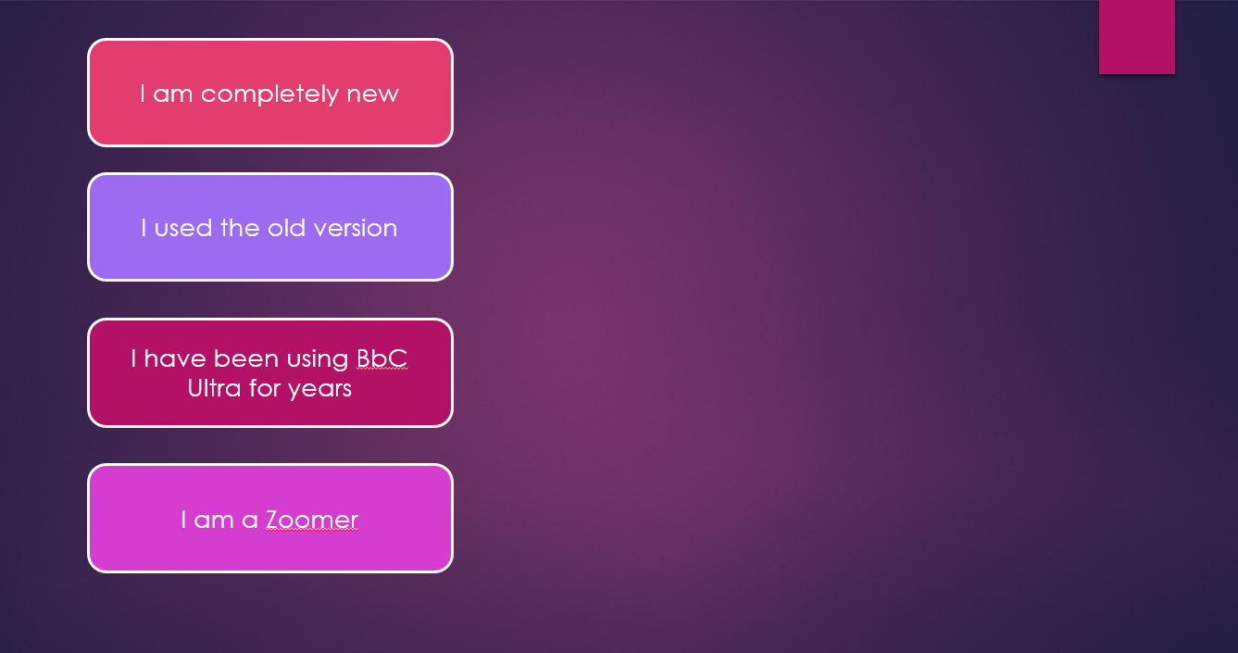

Collaborate experience?

Slide 8
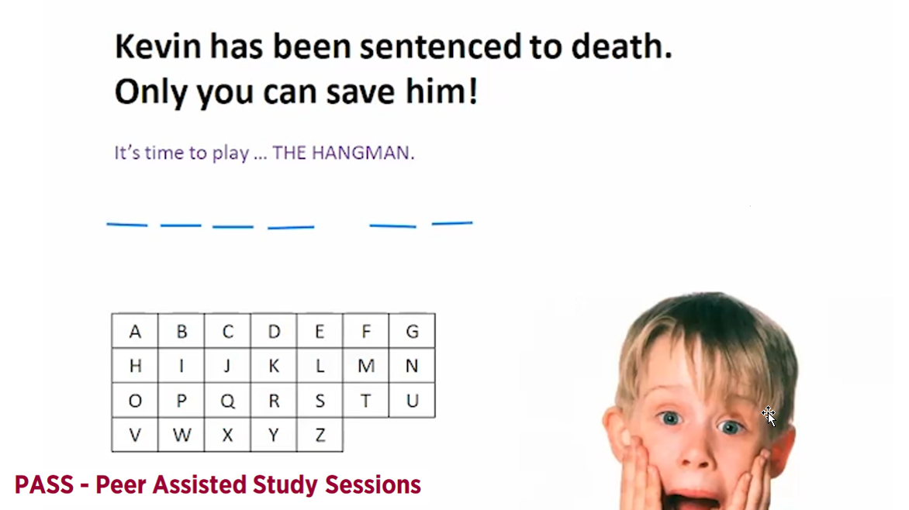

Slide 9

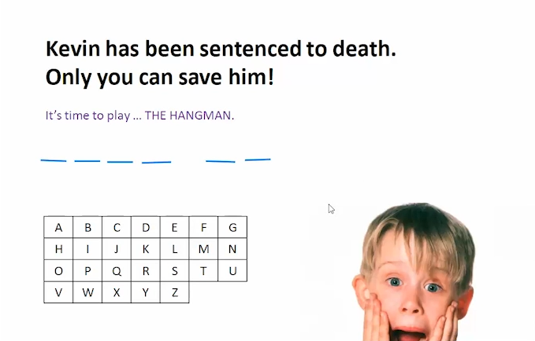
Whiteboard and Annotation

Slide 10
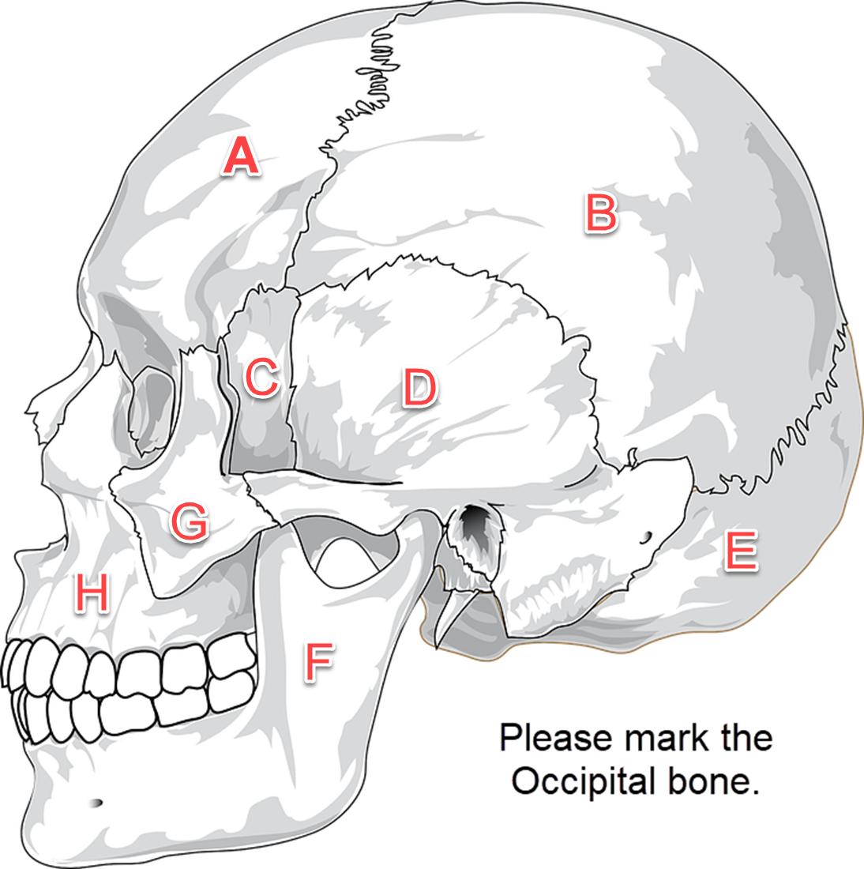
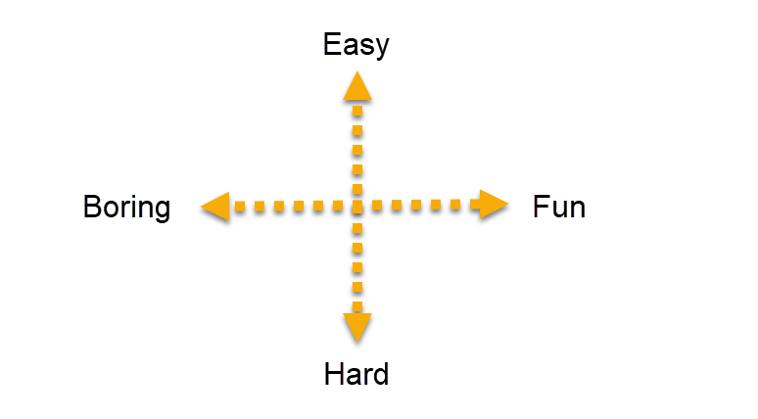
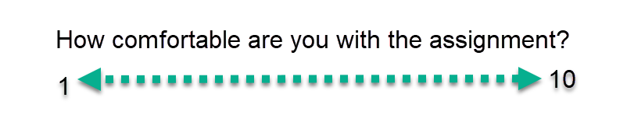

Slide 11
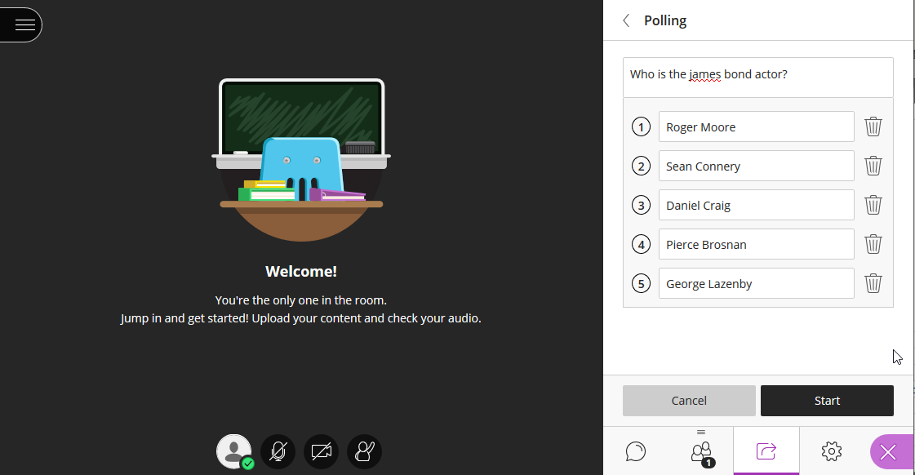

Slide 12
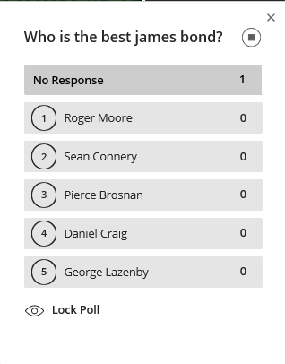
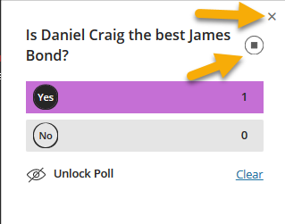

Slide 13
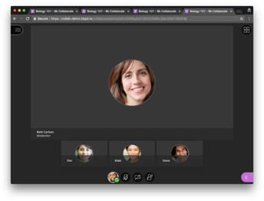
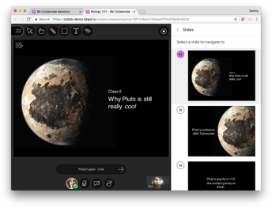
Back to it –
What is Bb Collab Ultra?
It is not the old version of Blackboard Collaborate – it is entirely new!

Slide 14
User Interface
Tour
Lets Watch!

Slide 15
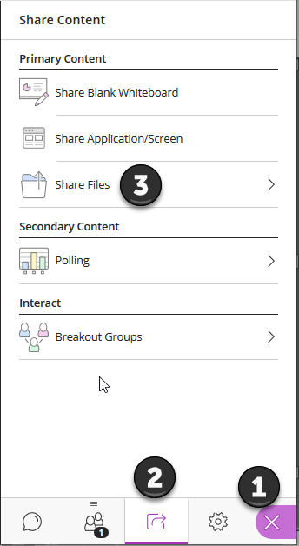
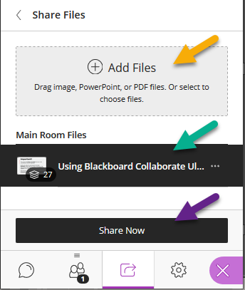
Sharing Files

Slide 16
What have I shared so far?
Uploading / Sharing Powerpoint
Polls
Whiteboard / Annotation
Full Screen – Youtube Video

Slide 17

Similarities

Slide 18
Differences

Slide 19
What do participants need?
General Resources
Computer – Windows 10 or Mac OS 10.13+
Web Browser – Firefox, Chrome or Safari
Reliable Internet

Slide 20
Accessibility
Standards
WCAG 2.1 Level AA
(web content accessibility guidelines)
VPAT
(voluntary product assessment)
Screen Reader
Windows 7 & 10 – Firefox with Jaws v17
Mac OSX – Safari with Voiceover
Captioning
Caption files (.VTT & .SRT)
Live Captioning + Captioner role
Multiple per language
Keyboard Shortcuts
Global keyboard shortcuts for common actions, plus:
    Alt M – Microphone
    Alt C - Video
    Alt H – Hands Up

Slide 21
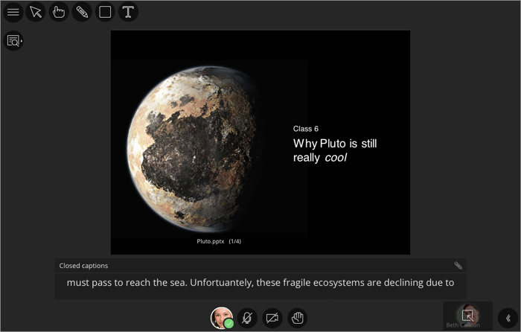

Slide 22
Tips and Tricks
Hold a early low-risk Bb Collaborate session with students ahead of time
If recording, add a warning disclaimer
Remember many students have bandwidth challenges. Support students using chat over video, phone-in options, and make recordings available
Prepare your space – remember your background, use a headset
Remind students – mute themselves!

Slide 23
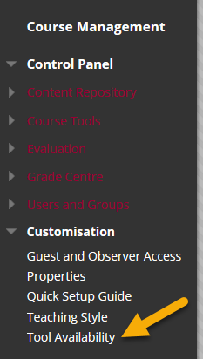
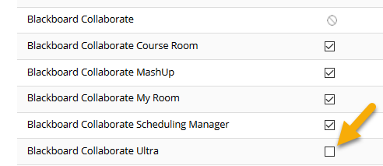
How to enable?
Scroll down to Course Management => Control Panel => Tool Availability
Tick Blackboard Collaborate Ultra
Click Submit

Slide 24
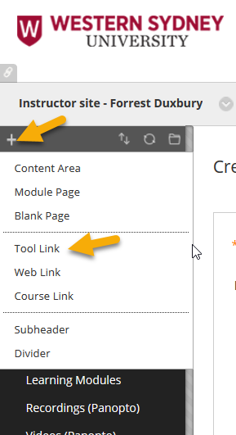

How to share?
In the menu, click the +, click Tool Link
Name the Link
Click Submit
Staff and students can then access the tool here:
5) Alternatively, can provide a guest link (like today)

Slide 25
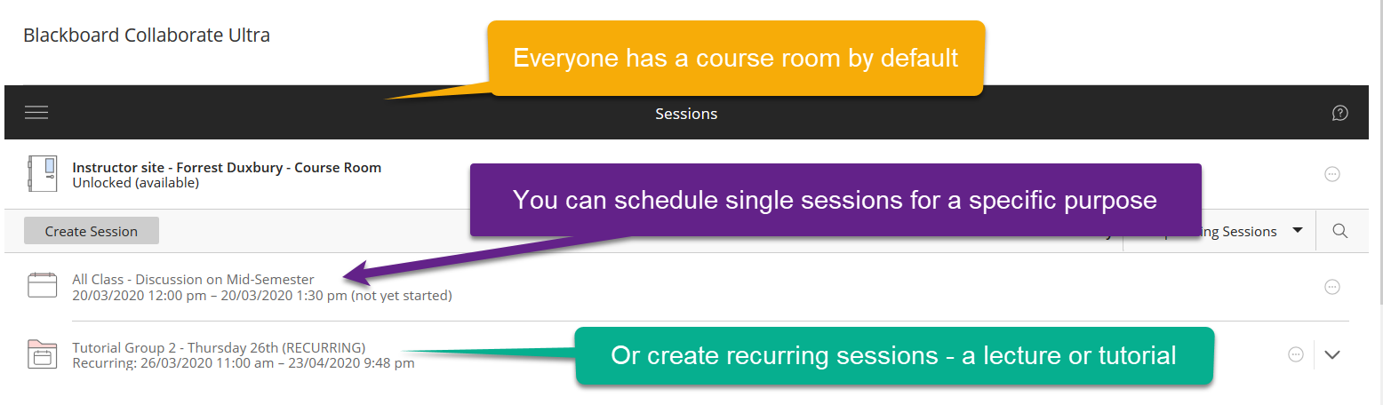
Clicking on the link

Slide 26
Course Room vs Scheduled Room
Course Room
  Permanently open
  Great for a drop-in communication place or for units with small enrolments
  Scheduled Rooms
  Prescheduled (easy)
  Great for larger units with multiple cohorts
  Repeatable
  Opens at specific time, can allow early entry

Slide 27
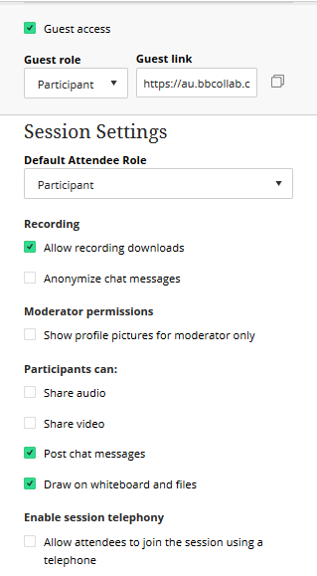
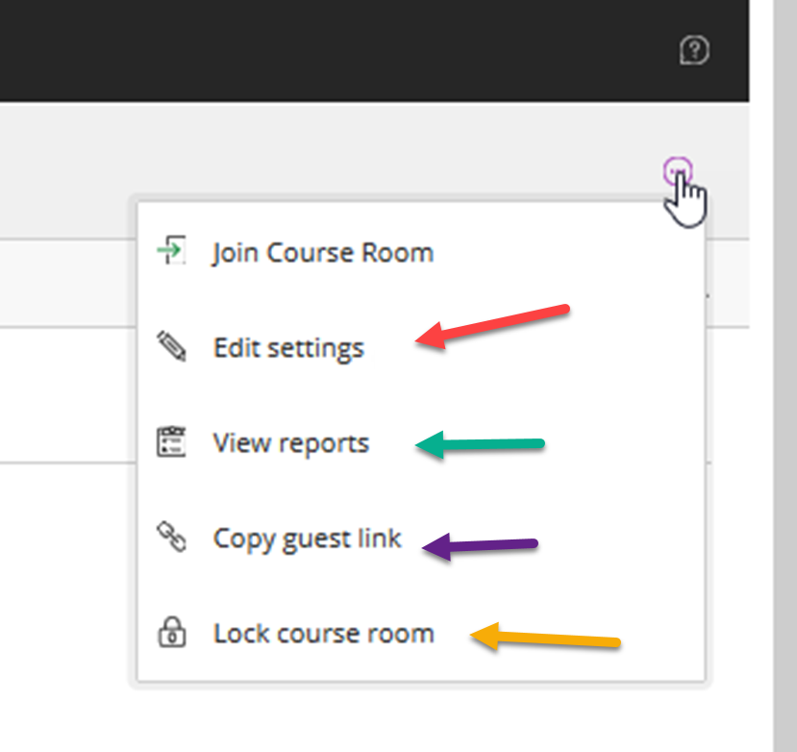
Where are the settings?

Slide 28
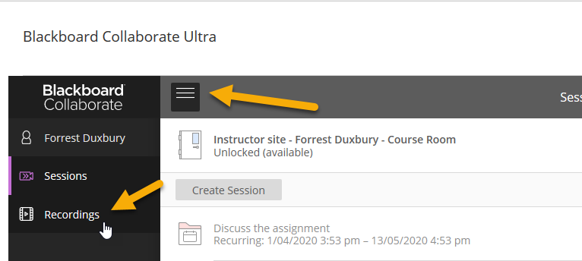
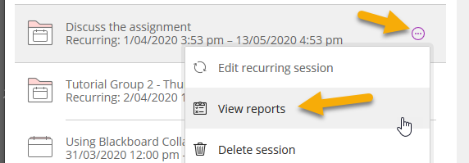
Recordings →
← Reporting

Slide 29
Further information
Western Sydney Support Resources
https://dft.westernsydney.edu.au/support/
https://wsu.service-now.com/it
New Learning Futures Resources
Virtual Classroom Comparison Matrix
Bb Collaborate Ultra – Features
Blackboard Resources
Blackboard Collaborate Ultra – Moderator Support
Blackboard Collaborate Ultra – Student Support
Blackboard Collaborate Ultra - Accessibility

Slide 30
Need help?
Contact Us – dft@westernsydney.edu.au
Contact IT – itservicedesk@westernsydney.edu.au

