Slide 1
vUWS Orientation
Presenter: Stephanie Lynch
Digital Learning Administration Officer,
Learning Futures

Slide 2
ACKNOWLEDGEMENT OF COUNTRY

Slide 3
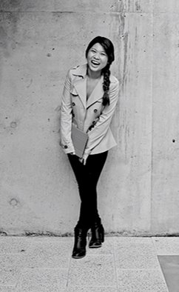
Welcome!
Today we will cover:
How to access vUWS
Navigating your vUWS site
Cortex Template
Basic editing in vUWS
Managing the Content Repository
Overview of the Grade Centre
Other Tools available in vUWS
Where to get help

Slide 4
How to access vUWS
1. The easiest way to navigate to vUWS is through the WSU home page
2. vUWS tab at top of page
3. Log in using WSU credentials. Staff email (staff number version)

Slide 5
Companion site: are non teaching sites
Overview of vUWS
landing page
On the landing page, you will see your vUWS sites. There are Subject and Companion sites.
At the top of the page you can also find the EDMM tab, as well as an abundance of resources for both staff and students.
Subject site: are teaching sites

Slide 6
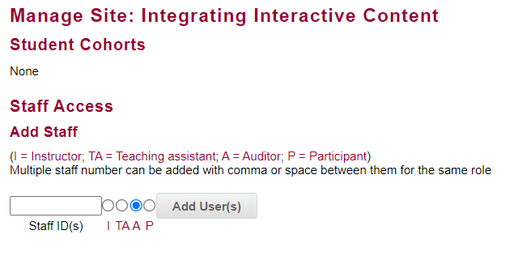
EDMM
On this page you can request a new vUWS site by clicking the tab and then completing a form for a new site. This can be a copy of a previous site that you would like to be rolled over.
Note: ITDS will automatically open vUWS site 1 week prior to session commencing.
Under the tab Manage site, you can add users by typing in their staff number and selecting an access level. Here you can also delete a user.

Slide 7
Navigating your vUWS site
Edit mode & Student preview
Enter Student Preview - view the set up from a student perspective. An orange bar along the top will appear for the duration.
Edit Mode - needs to be on when you are wanting to make any changes

Slide 8
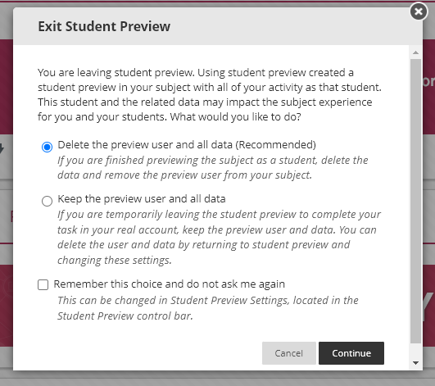
Navigating your vUWS site
Delete: recommended if you are just viewing site and modules.
Keep: If you are testing assessments as a student and submit them, you may like to keep the data so you can then mark them as an instructor.

Slide 9
Cortex
Template
The Cortex template has been designed to make the vUWS site accessible, engaging, presentable and consistent with other vUWS sites. Every content area will have the [Template].
1. Place your mouse cursor over the Item title and click the downward facing arrow, and then select Copy.
2. A new window will load. From the Destination Course dropdown menu select the name of the site you wish to copy the item.
3. Beside Destination Folder click Browse
4. Select the folder where you wish to copy to.
5. Click Submit.
Copying the [Template] back into folder

Slide 10
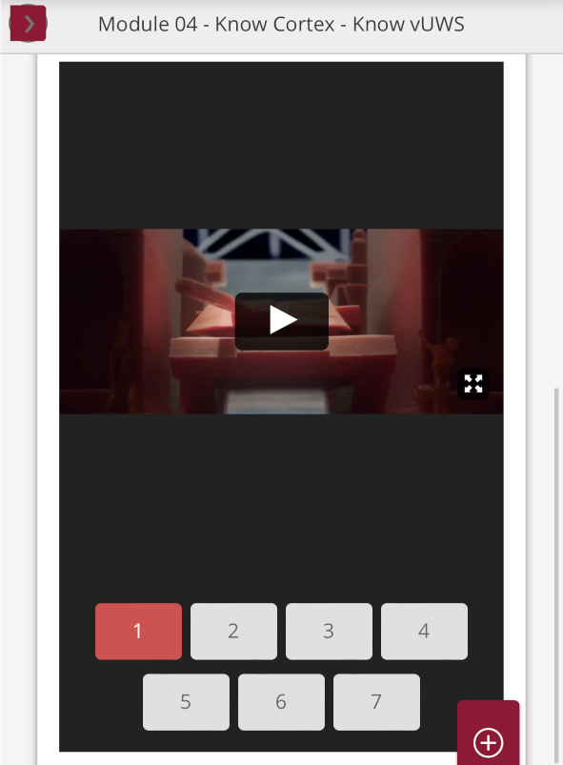
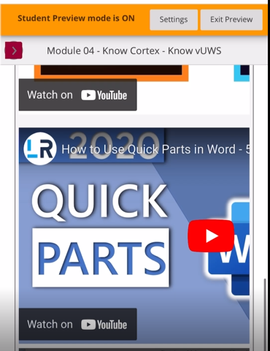
Cortex
Student view on mobile device with template.
You can see the item and video is centred to the device and also has the option to skip through video’s 1-7.
Student view on mobile device without template.
You can see that without the [Template] the video does not fit within the screen and you lose the multiple video function, you will need to scroll through numerous videos.

Slide 11
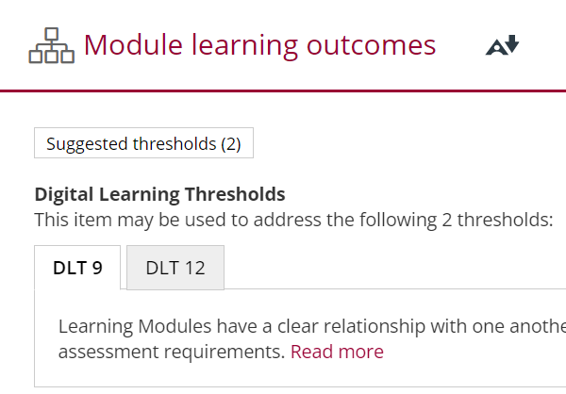
Cortex
Digital Learning Thresholds
DLTS have replaced QMs.
There are 20 DLTS
Click Suggested Learning Thresholds
Your DLTs will appear, you can select read more for more information on the particular DLT
Digital Learning Thresholds: https://lf.westernsydney.edu.au/engage/technology/digital-learning-thresholds

Slide 12
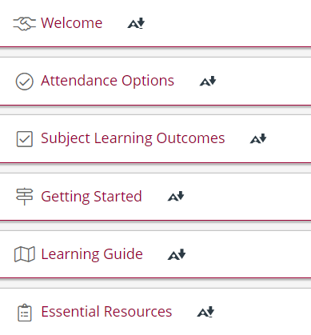
Cortex
Icons
By using a set of naming conventions when naming items a unique code will appear.
You can view the naming conventions on the below site:
https://lf.westernsydney.edu.au/docs/template-icons/index.html

Slide 13
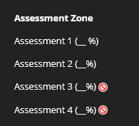
Navigating your vUWS site
Panel on left hand tab
4 zones that students will see, these should never be deleted:
Learning Zone
Communication Zone
Assessment Zone
Support Zone
Subject management – this is only visible to staff, students do not see this section.
Red cancel icon means the item is hidden from students. Hover mouse over line and a downward arrow will appear You can select Show Link / Hide / Rename / Delete

Slide 14
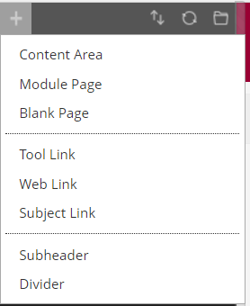
Navigating your vUWS site
Adding a content item
To create a new content area click the plus icon in the top left hand side of the menu then select content area, give the area a name and select if you want this to be visible to students at this point in time. The item will appear at the bottom on the panel you can move this up.
Note: Remember to copy the [Template] into the area.
To create a tool link such as Panopto, Journal, Zoom links click the plus icon in the top left hand side of the menu then select tool link, give the area a name and select if you want this to be visible to students at this point in time. The item will appear at the bottom on the panel you can move this up.

Slide 15
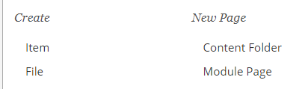
Basic editing in vUWS
Building Content
To create an item you will need to go into one of your content areas you will see a task bar with option to Build content.
Detailed instructions on creating/editing an item in vUWS can be found here; https://lf.westernsydney.edu.au/support/#content-editor
It is important to know that due to the template placed on each page, you will be limited with some formatting to ensure the site is accessible. The template has been set up with the Western branded theme which will override any colours you have applied.

Slide 16
Content Repository
The content repository is a file manager for your vUWS site.
We recommend that your documents are uploaded here first for example Learning guides, images, PDFs etc.
Note: Videos should be uploaded to Panopto not Content Repository. There is limited data storage available on vUWS sites.
Detailed instructions on creating folders and adding items can be found here; https://lf.westernsydney.edu.au/support/#content-repository
Accessing the Content Repository:
Log in to vUWS
Go to your vUWS site
Ensure Edit Mode is ON
On the left menu, click to expand Content Repository, located within the Control Panel under the Course Management section
Click on the link which contains your site's subject number

Slide 17
Grade Centre
Navigating Grade Centre
Once you have opened the Full Grade Centre you will see your columns.
The first columns are default and in every vUWS sites, they are then followed by columns that correspond to your assessments.
It is suggested that you clean up your grade centre columns before session starts. You may have a lot of columns from previous years which makes navigating and marking in the grade centre difficult. It is best to avoid doing this during session as a grade made have been put in.
Note: Once a column has been deleted, it cannot be retrieved, so it is recommend that before you delete a column you ensure a copy of the grade centre is downloaded.
Accessing the Grade Centre:
Log in to vUWS
Go to your vUWS site
Ensure Edit Mode is ON
On the left menu, click to expand Grade Centre
Click on Full Grade Centre

Slide 18
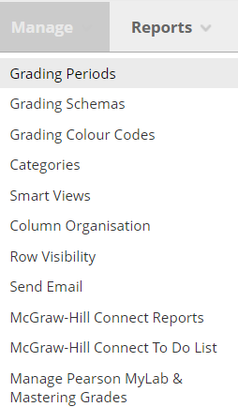
Grade Centre
Column Management
Moving order of columns:
Hover Mange
Column organisation
Click and hold 4 arrows and drag to preferred order
OR Click on up and down arrows on right hand side
Move up or down using arrows
Submit

Slide 19
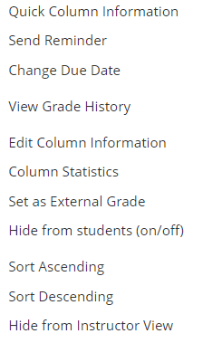
Grade Centre
Column Management
Hiding columns:
To hide columns all together meaning from instructor and students, you will first need to hide the column on the main full grade centre page, you will see a red cancel icon appear.
Once this is complete, follow the below steps;
Hover Mange
Column organisation
Tick the box/s you wish to hide
Scroll down and click hide column
Submit

Slide 20
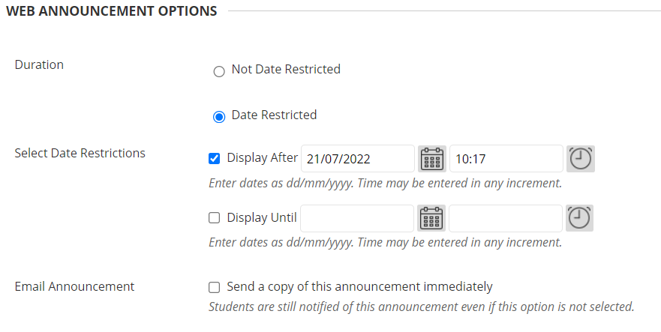
Announcements
On the left menu, under Communication Zone
Click on Announcements, Then create announcement
Creating an announcement
Duration / Date: Once you have given your announcement a title and text, scroll down to the Web Announcement Options.
Here you will have the option to send straight away or select a date that you wish for the announcement to appear.
Email Announcement: You will also have the option to email a copy to the student, this will go to their student email address.

Slide 21
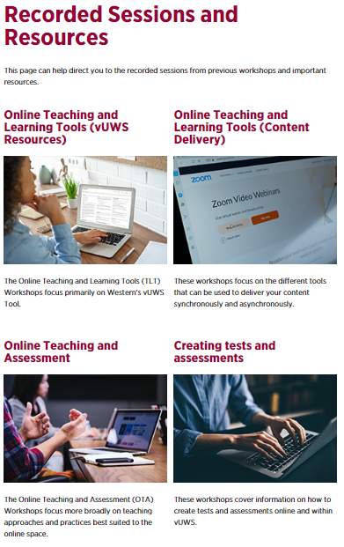
Further information
You can also find other Training Sessions on the Learning Futures Workshop Schedule website.
Self help articles (vUWS support): https://lf.westernsydney.edu.au/support/
Support - Contact us at Western Now

Slide 22
End
Notes:
Any questions?

