Slide 2
Intro to WOS Western One Stop Studio
Presenter: Diane Camilleri
Wing: Emina Mujanovic
LEARNING FUTURES
Notes:
Intro to WOS

Slide 3
SESSION PLAN
What is WOS?
How to book a WOS recording?
The booking process
Preparing for your WOS recording
What to expect during your recording?
What to expect after your recording?
Notes:
What is WOS?
How to book a WOS recording
The booking process
Preparing for your WOS recording
What to expect during your recording
What to expect after your recording

Slide 4
WHAT IS (WOS) ?
Western One Stop Studio is a custom-built lecture pod capture system designed to assist you to make short and simple, high quality lecture pods. It’s been designed in-house, here at Western Sydney by our Learning Futures team.
All you’ll need is your PowerPoint presentation on a USB and yourself, ready to record.
Kingswood and Parramatta South locations open
Notes:
Western One Stop Studio is a custom-built lecture pod capture system designed to assist you to make short and simple, high quality lecture pods. It’s been designed in-house, here at Western Sydney by our Learning Futures team.
All you’ll need is your PowerPoint presentation on a USB and yourself, ready to record
Kingswood and Parramatta South locations open – Milperra, Campbelltown, Parramatta City & Liverpool are currently closed due to no staff capacity to run these locations.

Slide 5
WHAT IS (WOS) ?
Notes:
Play video

Slide 6
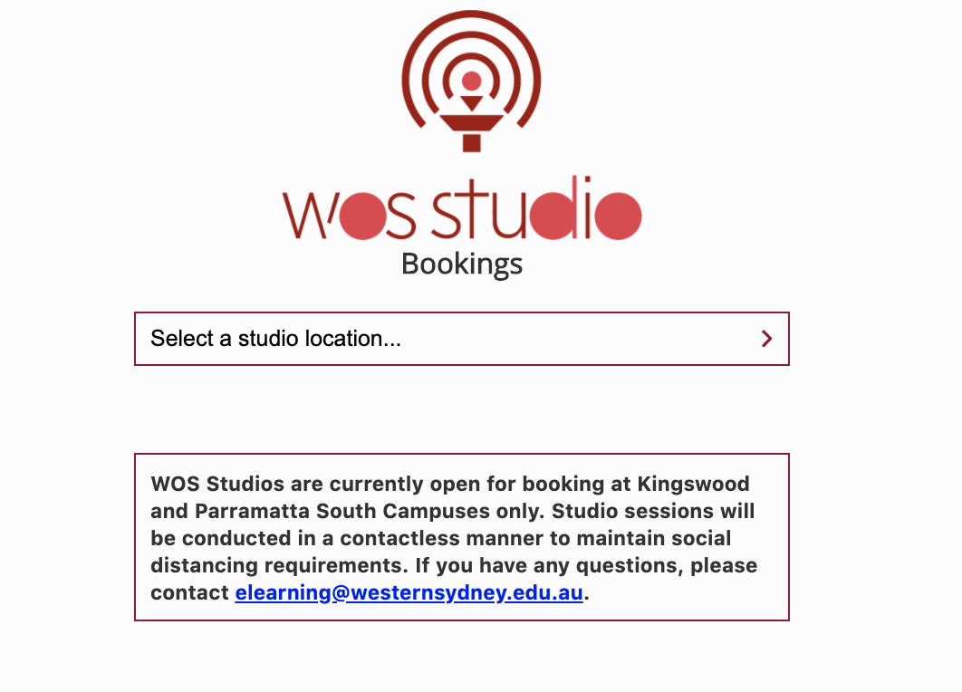
HOW TO BOOK A WOS RECORDING?
WOS bookings are completed through the online booking form.
https://lf.westernsydney.edu.au/wos/
Notes:
How to book a WOS recording
Go to booking site and show how to submit a booking.
https://lf.westernsydney.edu.au/wos/

Slide 7
THE BOOKING PROCESS
Submit Booking
Rejection Email
You will need to re-submit request
Booking submitted email
Confirmation email
COVID-19 Email
Notes:
Once you have submitted your booking you will receive an email saying your request is submitted. The system will reject your request automatically if there is an error. You will receive a ‘rejected email’ which means you will need to re-submit your request.
Reasons for rejection could include:
time or date selected not available, not booking with a WSU email address, or you already have a booking for that day (1 booking per person per day)
Once the request is received a WOS team member will cross check your request and confirm.
Once confirmed you will receive 2 emails – One confirming your booking which includes important information and one with COVID-19 updates and reminders.
If you need to cancel your booking you can click the ‘cancel this booking’ link in your confirmation email or email elearning@westernsydney.edu.au, please do this as earliest as possible. We will then send through an email to confirm the reason for your cancellation for reporting purposes.
Do not forward on confirmation emails to multiple people – anyone with the cancellation link can cancel on your behalf
Confirmations emails should be read to confirm details of your booking.
If you need to re-schedule or clarification on anything, just email elearning@westernsydney.edu.au and we’ll be able to answer your query.

Slide 8
PREPARING FOR YOUR WOS BOOKING
Prepare a PowerPoint presentation – use the WOS PowerPoint template
It is important that a presentation script is created
WOS Preparation guide is available for further details – link in chat (or found on WOS website)
Bring your completed presentation on a USB stick
Avoid wearing very dark colours or patterned designs like fine stripes or checks
Notes:
PREPARING FOR YOUR WOS BOOKING
Prepare a PowerPoint presentation – use the WOS PowerPoint template
Show how to prep the PowerPoint
Including the code, Bullet points, tabbed formatting, spelling errors, links, how to include a video from youtube, phonetically written or spelt out numbers will help reading.
It is important that a presentation script is created
At the heart of the WOS Studio is the teleprompter. This ensures your presentation is of high quality. To achieve this quality it is important the user develops a presentation script. This script is inserted in the Presenter Notes section at each of the corresponding slides in your presentation. This script is then displayed on the teleprompter during the recording session. WOS has a range of features to aid you in making great video pods. Visit the website for a complete guide to lecture pod preparation for WOS.
WOS Preparation guide is available for further details – link in chat (or found on WOS website)
Bring your completed presentation on a USB stick
Avoid wearing very dark colours or patterned designs like fine stripes or checks. Clothing branded with large logos or similar is not recommended.
Link for chat:
WOS Preparation Doc:
https://www.westernsydney.edu.au/__data/assets/pdf_file/0014/1520510/WOS-Prep_Guide-V1.2.pdf

Slide 9
WHAT TO EXPECT DURING YOUR RECORDING?
WOS Studios are supported by a WOS team member to guide you through the process
Social distancing rules apply in the studio at all times – the space can be quite small, as such the wearing of a face mask is recommended
The team member will check through your PowerPoint presentation
Your presentation will then be loaded into the system ready to record
The system will guide you through the set up process before recording begins
Once recording begins you will control the pace of the moving text in the teleprompter
If you make a mistake simply press the top button and you will start at the top of the slide
Notes:
WOS Studios are supported by a WOS team member to guide you through the process
Studios are supported by the WOS Studio Team. WOS Staff will guide you through the recording process and be on hand to answer your questions. If you are a first-time user, a WOS Studio Team member will provide a short orientation to familiarise you with the process before you begin.
Social distancing rules apply in the studio at all times – the space can be quite small, as such the wearing of a face mask is recommended
The team member will check through your PowerPoint presentation
Your presentation will then be loaded into the system ready to record
The system will guide you through the set-up process before recording begins
Once recording begins it will take you through all slides recording all the way through, making mistakes are easy to correct

Slide 10
WHAT TO EXPECT AFTER YOUR RECORDING?
Your video will be post produced by WOS support staff
Your final mp4 video will be sent via email - can take up to 7 working days after your recording
Panopto link, Panopto embed code and cloudstor link
Check through your video to ensure everything is accurate
Create a local back up on your computer
Notes:
Your video will be post produced by WOS support’ staff
Video pods will be post produced by a WOS Team member and will generally be ready for deployment within 7 working days.
Your final video will be sent via email - 7 working days after your recording
Once you have received your completed pod, check it through thoroughly.
Panopto link, Panopto embed code and cloudstor link
Check through your video to ensure everything is accurate
Create a local back up on your computer
Make a backup of this file along with your original PowerPoint file for future use and revisions.

Slide 11
Support and Resources

Slide 12
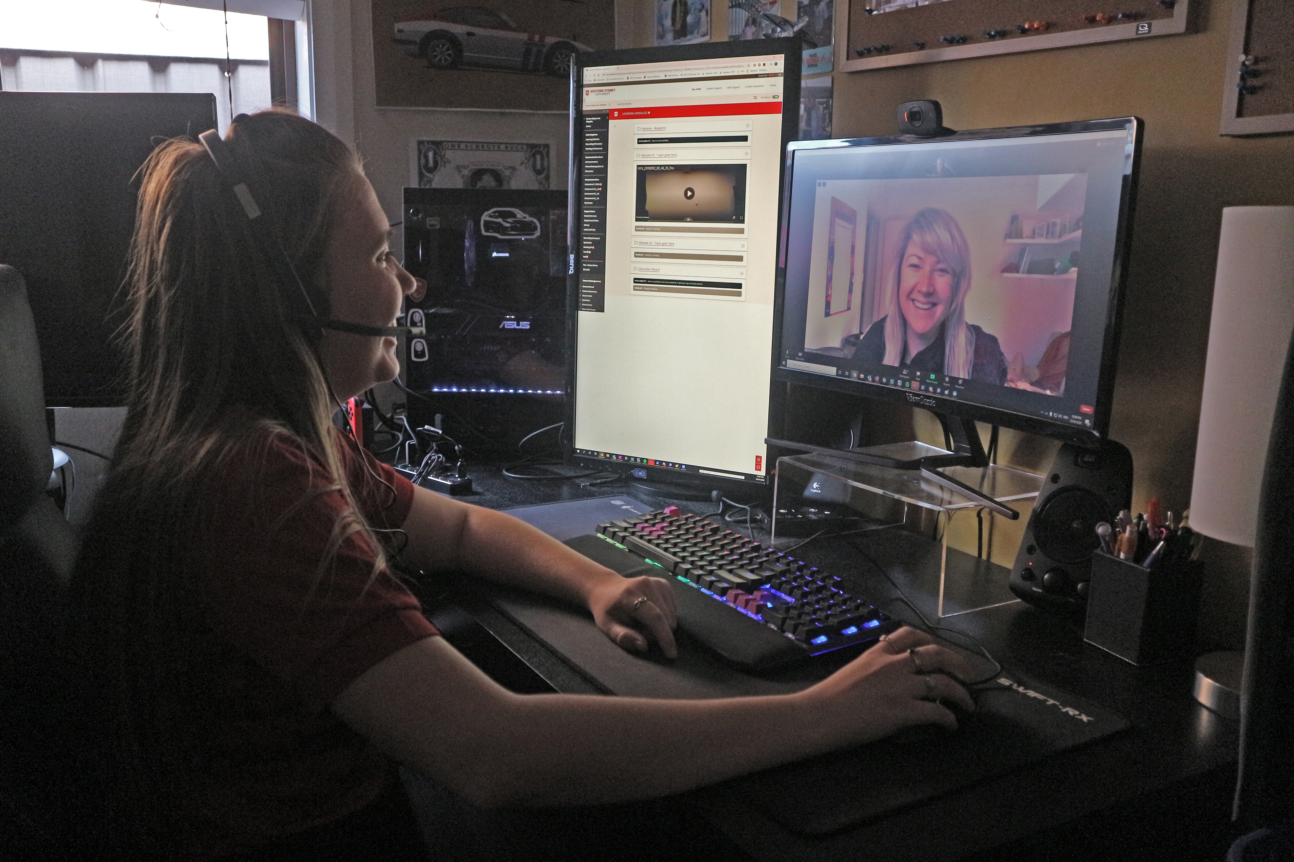
eLearning Support One to One (101)
Would you like to learn more about vUWS Blackboard tools and functionalities to enhance teaching and learning experience?
Learning Futures team is now able to offer personalised one-on-one eLearning support session via a zoom appointment. If you have any vUWS related queries, a member of our eLearning support team will support you through a tailored session specific to your needs.
Book a session today using our online form https://forms.gle/23UoDvsvSoybqHgZ6
If you have any additional queries, our contact email is elearning@westernsydney.edu.au
Notes:
Would you like to learn more about vUWS Blackboard tools and functionalities to enhance teaching and learning experience?
Learning Futures team is now able to offer personalised one-on-one eLearning support session via a zoom appointment. If you have any vUWS related queries, a member of our eLearning support team will support you through a tailored session specific to your needs.
Links for Chat:
One on one Consultation link:
https://forms.gle/23UoDvsvSoybqHgZ6

Slide 13
Additional Resources
Training
Learning Futures online workshops
Recorded sessions and resources
Support
Contact eLearning Support: elearning@westernsydney.edu.au
Book a One-on-One Consultation
Notes:
Links for Chat:
Workshop Schedule
https://bit.ly/2Sk7Pmh
Recorded Sessions and Recourses
https://bit.ly/3cZNGcO

Slide 14
Questions

Slide 15
Feedback
Notes:
Friendly URL:
https://bit.ly/2YlU2Q1
Full URL:
https://docs.google.com/forms/d/15N0gQ0jB8igmN7svdO0i2VlbEg6qwIiXRVEmZUNtkoo/viewform?ts=5e81804a&edit_requested=true

Slide 16
Tell us what you think!
Did you like the workshop design and delivery?
What would you like to know more about?
Copy and paste the URL in the chat. It should only take 3min (we promise!)
We actually use your feedback to fine-tune, create and schedule future workshops
Notes:
Links for Chat:
Workshop Schedule
https://bit.ly/2Sk7Pmh
Recorded Sessions and Recourses
https://bit.ly/3cZNGcO
Feedback link:
https://bit.ly/2YlU2Q1

Slide 17
Thank you for attending
Notes:
Links for Chat:
Workshop Schedule
https://bit.ly/2Sk7Pmh
Recorded Sessions and Recourses
https://bit.ly/3cZNGcO

Slide 18
Notes:
Thank you for your time

