Slide 1
Creating an online learning community
Glenn Mason, Learning Science Analyst*
Hermy Llacuna, Learning Science Analyst*
Kim Vincent, Lead Learning Science Analyst*
*Learning Futures, Western Sydney University

Slide 2
Housekeeping
The session will be recorded
If you don’t wish to be recorded please switch off your video
Bandwidth
Consider turning off your video if bandwidth is an issue
Only turn on microphone when speaking
Dropouts
If we drop out the session will be recorded and made available
If you drop out the recording will be available after the session
Turning learning on its head
Creating an online learning community

Slide 3
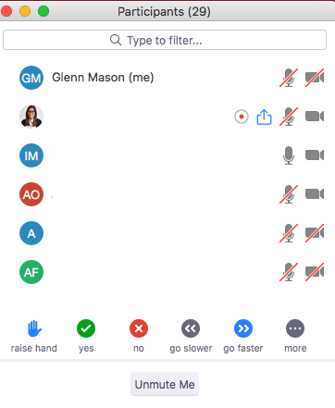
Interaction management
Raise your Zoom hand if you have a question
To maximise your ‘social presence’ please turn your video on but if bandwidth is an issue please feel free to turn off
Turning learning on its head
Creating an online learning community

Slide 4
Objectives
At the end of this session you will be able to:
Plan to apply the concept of an online learning community to your unit
Plan to apply scaffolding techniques in your online learning community
Apply synchronous and asynchronous tools that can be used to sustain your online learning community
Turning learning on its head
Creating an online learning community

Slide 5
Warm up
Introduce yourselves
Think about how you can promote a sense of
belonging in your community
If there are enough participants we can try
breakout rooms!
Turning learning on its head
Creating an online learning community
Notes:
What happens, however, when lecture theatres are removed and replaced by learning spaces without characteristics traditionally associated with lecture settings such as the ability to accommodate 100s of students in one place at any one time? What happens when the 1 to many relationship between teacher and student in a lecture setting is no longer sustainable?

Slide 6
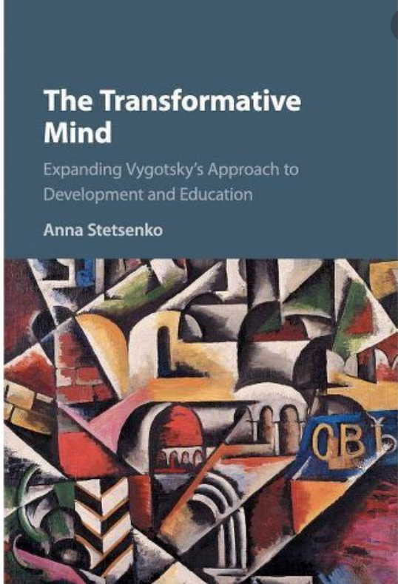
Introduction to the idea of an online learning community
Learning is a social process
Social interaction plays a fundamental role in cognitive development (Vygotsky)
Further reading…
If you’re interested!
Turning learning on its head
Creating an online learning community
Notes:
What happens, however, when lecture theatres are removed and replaced by learning spaces without characteristics traditionally associated with lecture settings such as the ability to accommodate 100s of students in one place at any one time? What happens when the 1 to many relationship between teacher and student in a lecture setting is no longer sustainable?

Slide 7
Introduction to the idea of an online learning community
Scaffolding
- Vygotsky’s concept of the zone of proximal development (ZPD) = what you can attain with social interaction exceeds what you can attain individually
Vygotsky’s concept
of ZPD
Jerome Bruner
had similar ideas
Turning learning on its head
Creating an online learning community
Notes:
What happens, however, when lecture theatres are removed and replaced by learning spaces without characteristics traditionally associated with lecture settings such as the ability to accommodate 100s of students in one place at any one time? What happens when the 1 to many relationship between teacher and student in a lecture setting is no longer sustainable?

Slide 8
Introduction to the idea of an online learning community
Knowledge construction
Students construct knowledge through social interaction…Scardamalia and Bereiter’s work in online space
Turning learning on its head
Creating an online learning community
Notes:
What happens, however, when lecture theatres are removed and replaced by learning spaces without characteristics traditionally associated with lecture settings such as the ability to accommodate 100s of students in one place at any one time? What happens when the 1 to many relationship between teacher and student in a lecture setting is no longer sustainable?

Slide 9
Introduction to the idea of an online learning community
Putting this altogether…
Learning is a social process +
scaffolding + online tools
= cognitive development in online space
BUT…
Turning learning on its head
Creating an online learning community
Notes:
What happens, however, when lecture theatres are removed and replaced by learning spaces without characteristics traditionally associated with lecture settings such as the ability to accommodate 100s of students in one place at any one time? What happens when the 1 to many relationship between teacher and student in a lecture setting is no longer sustainable?

Slide 10
Introduction to the idea of an online learning community
So far…focus on cognitive development
Need to create a community of learners!
- Community of Inquiry model
- Salmon’s five stage model
Turning learning on its head
Creating an online learning community
Notes:
What happens, however, when lecture theatres are removed and replaced by learning spaces without characteristics traditionally associated with lecture settings such as the ability to accommodate 100s of students in one place at any one time? What happens when the 1 to many relationship between teacher and student in a lecture setting is no longer sustainable?

Slide 11
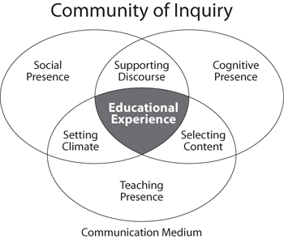
Introduction to the idea of an online learning community
Social presence
Group cohesion – encourage collaboration
Safe environment for discussion – forum for open discussion and debate
Teaching presence
Management of instruction – facilitation, starting discussions, focussing discussions
Building meaning – synthesising knowledge from students
Cognitive presence
Integration and resolution – connecting ideas and applying concepts
Posing initial questions/problems – create a culture of ongoing inquiry
Turning learning on its head
Creating an online learning community
Notes:
What happens, however, when lecture theatres are removed and replaced by learning spaces without characteristics traditionally associated with lecture settings such as the ability to accommodate 100s of students in one place at any one time? What happens when the 1 to many relationship between teacher and student in a lecture setting is no longer sustainable?

Slide 12
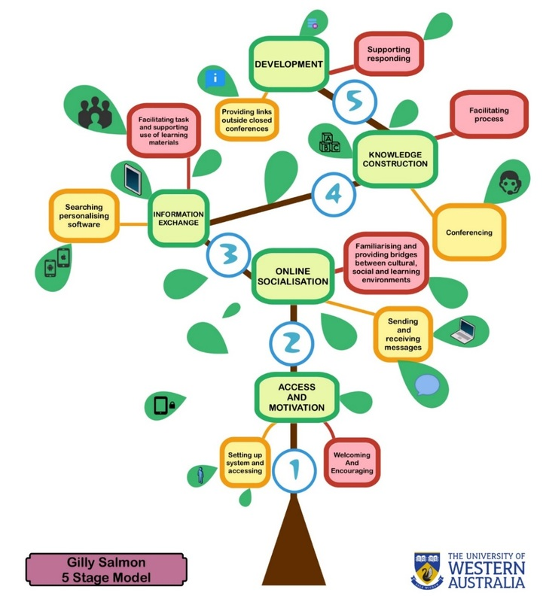
Building a community
Turning learning on its head
Creating an online learning community
Notes:
What happens, however, when lecture theatres are removed and replaced by learning spaces without characteristics traditionally associated with lecture settings such as the ability to accommodate 100s of students in one place at any one time? What happens when the 1 to many relationship between teacher and student in a lecture setting is no longer sustainable?

Slide 13
Building a community
Access and motivation. Welcome your students – make them feel part of the community.
Online socialisation. Introduce activities to help your students get to know each other and feel part of a community.
Activities: Provide students with opportunity to introduce themselves through zoom. Ask why have they enrolled in the unit? What have they done in previous units? How does it relate to career/scholarly goals etc?
Information exchange. Begin to set tasks which require information/knowledge exchange among your students.
Knowledge construction. Help to facilitate student discussions (synchronous or asynchronous) and to promote knowledge construction through social interaction and discourse.
Activities: Small group discussions, problem-based learning, brainstorming, group presentations, peer feedback, reflection on learning etc.
Turning learning on its head
Creating an online learning community
Notes:
What happens, however, when lecture theatres are removed and replaced by learning spaces without characteristics traditionally associated with lecture settings such as the ability to accommodate 100s of students in one place at any one time? What happens when the 1 to many relationship between teacher and student in a lecture setting is no longer sustainable?

Slide 14
Building a community
Development. Your students will have more confidence to apply their knowledge to novel contexts. New knowledge can be applied to assessment tasks.
Activities: Problem-based learning, team-based learning, authentic learning scenarios, role plays, small group discussion etc.
Turning learning on its head
Creating an online learning community
Notes:
What happens, however, when lecture theatres are removed and replaced by learning spaces without characteristics traditionally associated with lecture settings such as the ability to accommodate 100s of students in one place at any one time? What happens when the 1 to many relationship between teacher and student in a lecture setting is no longer sustainable?

Slide 15
Activity
Choose one activity from one of your units
Choose one or more of the five dimensions from the Salmon model
How can you apply the dimension to your unit to create a stronger learning community?
When you’re ready, post up your ideas here:
https://tinyurl.com/ctyworkshop
Turning learning on its head
Creating an online learning community
Notes:
What happens, however, when lecture theatres are removed and replaced by learning spaces without characteristics traditionally associated with lecture settings such as the ability to accommodate 100s of students in one place at any one time? What happens when the 1 to many relationship between teacher and student in a lecture setting is no longer sustainable?

Slide 16
Further considerations
Assessment
Appropriate scaffolds to help students attempt assessment tasks
Turning learning on its head
Creating an online learning community
Notes:
What happens, however, when lecture theatres are removed and replaced by learning spaces without characteristics traditionally associated with lecture settings such as the ability to accommodate 100s of students in one place at any one time? What happens when the 1 to many relationship between teacher and student in a lecture setting is no longer sustainable?

Slide 17
Asynchronous tools - discussion board
Spin
Weave
Spin
Weave
Springboard posts
Warm-up activities
Hurdles/challenges for the week
Frame the week
Spin and weave
Initiate discussion. Post a thread (spin) that summarises some of the issues from the previous week and pose a question for the group to kick off the next session.
To sustain the discussion, respond to individual posts with further questions or start a new thread that synthesises some of the ideas.
At the end of the week (or session), synthesise (weave) the ideas from the discussion forum. This can be used to kick off the discussion for any subsequent forums.
If students are primarily responsible for this activity it is important that you ensure your ‘teacher presence’ once every 24 hours.
Turning learning on its head
Creating an online learning community
Notes:
What happens, however, when lecture theatres are removed and replaced by learning spaces without characteristics traditionally associated with lecture settings such as the ability to accommodate 100s of students in one place at any one time? What happens when the 1 to many relationship between teacher and student in a lecture setting is no longer sustainable?

Slide 18
Asynchronous group work
Use the vUWS group function to set spaces where students can share files, have discussions and create a space to work asynchronously.
Considerations:
Asynchronous group work requires management to encourage participation.
Timing
Online group work usually takes longer than face-to-face.
Set ground rules for participation such as when participants should get back to the group to discuss their findings/results/ideas.
Expectations
Goals of the activity and how is each member accountable?
Use a statement of work plan
Turning learning on its head
Creating an online learning community
Notes:
What happens, however, when lecture theatres are removed and replaced by learning spaces without characteristics traditionally associated with lecture settings such as the ability to accommodate 100s of students in one place at any one time? What happens when the 1 to many relationship between teacher and student in a lecture setting is no longer sustainable?

Slide 19
Synchronous – Collaborate or Zoom
Framing content. Are you going to use Collaborate or Zoom to provide a lo-fi introduction to a difficult concept? Or for the start of a new topic?
Assignment-focused. Use a session to discuss assignment specific issues/questions
Drop-in Q&A. This could be used for general questions about the unit.
Workshopping
Lecture style. Consider using Collaborate to deliver an orthodox lecture if required
Learning practice and behaviour. To discuss any tips or strategies that may be useful for your students [link to preparing your students for online learning].
Turning learning on its head
Creating an online learning community
Notes:
What happens, however, when lecture theatres are removed and replaced by learning spaces without characteristics traditionally associated with lecture settings such as the ability to accommodate 100s of students in one place at any one time? What happens when the 1 to many relationship between teacher and student in a lecture setting is no longer sustainable?

Slide 20
Other tools
Announcement in vUWS
Unit level for broader weekly communication
Overviews/reminders/progress checks
Information specific to the class/tutor
Other tools to increase teacher presence
Audio tools (e.g. audacity) to produce audio snippets of content
Screencasting (e.g. Screencast-O-Matic) or video
Turning learning on its head
Creating an online learning community
Notes:
What happens, however, when lecture theatres are removed and replaced by learning spaces without characteristics traditionally associated with lecture settings such as the ability to accommodate 100s of students in one place at any one time? What happens when the 1 to many relationship between teacher and student in a lecture setting is no longer sustainable?

Slide 21
Support
University services (e.g. counselling)
Policies (e.g. academic/general misconduct)
Expectations (e.g. netiquette and participation)
Turning learning on its head
Creating an online learning community
Notes:
What happens, however, when lecture theatres are removed and replaced by learning spaces without characteristics traditionally associated with lecture settings such as the ability to accommodate 100s of students in one place at any one time? What happens when the 1 to many relationship between teacher and student in a lecture setting is no longer sustainable?

Slide 22
Conclusion
Introduction to the community of inquiry model as foundation model for online learning community
Introduction to Salmon’s five stage model for design model to assist in the design of an online learning community
Introduction to synchronous and asynchronous tools to help you sustain an online learning community
“For apart from inquiry, apart from the praxis, individuals cannot be truly human. Knowledge emerges only through invention and re-invention, through the restless, impatient, continuing, hopeful inquiry human beings pursue in the world, with the world, and with each other.” Freire, Pedagogy of the Oppressed
Turning learning on its head
Creating an online learning community
Notes:
What happens, however, when lecture theatres are removed and replaced by learning spaces without characteristics traditionally associated with lecture settings such as the ability to accommodate 100s of students in one place at any one time? What happens when the 1 to many relationship between teacher and student in a lecture setting is no longer sustainable?

Slide 23
Themes from last workshop
Collaborative documents in asynchronous environmentsGoogle docs, Word online etc.
Tools to help students ‘create together’ - wikis etc.
Motivation of students to work in asynchronous mode
Make forums assessable (low-weight summative)
Spin and weave approach - provide students with more responsibility
Ensure students can only see other posts once they have posted.
Encourage teachers not to be concerned with high-production values in their videos
How do we integrate student communication in social media with formal educational tasks?
This is an ongoing issue
How do we promote belonging?
Can we distinguish between cognitive belonging and social belonging?
How can we leverage social media to promote belonging in formal learning environments?
Tips and strategies
https://www.youtube.com/watch?time_continue=1&v=D7vooDcxUaA&feature=emb_logo
Salmon talks about the first post in a discussion board like a group of people standing around a swimming pool
Turning learning on its head
Creating an online learning community
Notes:
What happens, however, when lecture theatres are removed and replaced by learning spaces without characteristics traditionally associated with lecture settings such as the ability to accommodate 100s of students in one place at any one time? What happens when the 1 to many relationship between teacher and student in a lecture setting is no longer sustainable?

Slide 24
Turning learning on its head
Creating an online learning community
Notes:
What happens, however, when lecture theatres are removed and replaced by learning spaces without characteristics traditionally associated with lecture settings such as the ability to accommodate 100s of students in one place at any one time? What happens when the 1 to many relationship between teacher and student in a lecture setting is no longer sustainable?

