Slide 1
Notes:
Welcome everyone, thank you for joining our Amazing Race themed workshops.

Slide 2
Road Block! Setting up Blackboard Rubrics and deploying the Rubric for marking
Presenter: Robert Ycasiano
Digital Learning Administration Officer,
Learning Futures
Notes:
Today is pitstop 4 which is titled: Road Block! Setting up Blackboard Rubrics and deploying the Rubric for marking, my name is Robert from Learning Futures and I will be your Digital Learning presenter for todays session.
Joining me today and monitoring the chat we have my colleague Stephanie Lynch and Rhoda O’Higgins in the Digital Learning team.

Slide 3
ACKNOWLEDGEMENT OF COUNTRY
With respect for Aboriginal cultural protocol and out of recognition that its campuses occupy their traditional lands, Western Sydney University acknowledges the Darug, Eora, Dharawal (also referred to as Tharawal) and Wiradjuri peoples and thank them for their support of its work on their lands (Greater Western Sydney and beyond).
Notes:
I would like to begin today’s workshop by acknowledging the Traditional Custodians of the land on which we meet today, and pay my respects to their Elders past and present. I extend that respect to Aboriginal and Torres Strait Islander peoples here today.
I am joining you today from [Darug] Land. You may wish to add in the chat which land you are joining us from.

Slide 4
Notes:
RECORDING/MUTE
Please note that this session will be recorded, please make sure your microphone is muted and disable your camera if you don’t want to be visible on the recording.
QUESTIONS
If you do have any questions, please post them in the chat and one of my colleagues will respond to you, I will also be available to answer your questions at the end of the workshop.

Slide 5
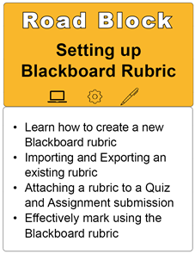
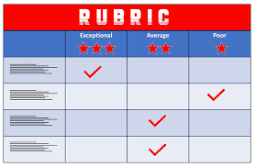
Notes:
In this session we will look over the following items:
Learn how to create a new Blackboard rubric
Importing and Exporting an existing rubric
Attaching a rubric to an Assignment submission
Effectively mark using the Blackboard rubric
Please note that this is a beginner level workshop.

Slide 6
What is a Rubric?
A rubric for assessment, is a tool used to interpret and grade students' work against criteria and standards.
Rubrics are sometimes called "criteria sheets", "grading schemes", or "scoring guides". Rubrics can be designed for any content domain.
You can use rubrics to structure discussions with students about different levels of performance on an assessment task.
Notes:
What is a Rubric?
A rubric for assessment, usually in the form of a matrix or grid, is a tool used to interpret and grade students' work against criteria and standards.
Rubrics are sometimes called "criteria sheets", "grading schemes", or "scoring guides". Rubrics can be designed for any content domain.
You can use rubrics to structure discussions with students about different levels of performance on an assessment task.

Slide 7
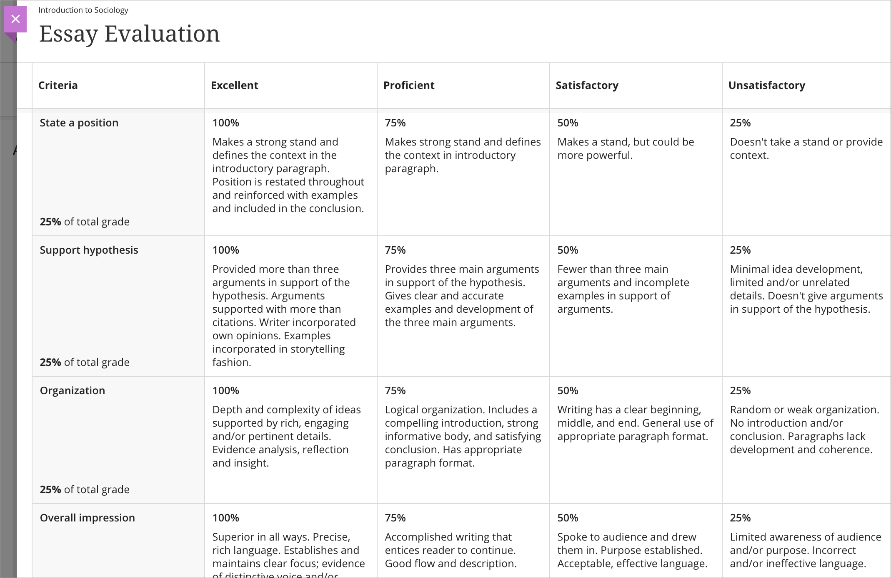
Examples of Rubrics:
Percentage:
Points:
Notes:
Here are some examples of some already created Rubrics:
On the horizontal axis, we have the scale or level of achievement, and the vertical axis we have the criteria
On the left example, we have a percentage rubric, with the left side being the highest mark and the right being the lowest mark possible.
Each Criteria is worth 25% of the mark, so if a student was to meet the requirements for Excellent along the scale for the Criteria: State a position. The student would get 100% of the 25%. Same concept applies if a student meets the requirements for Unsatisfactory, they will receive 25% of 25%.
On the right example, we have a points rubric, similar to the example on the left, we have the scale containing points 4, 3, 2, 1 with the left being the highest mark and the right being the lowest.
If a student was to meet the requirements for criteria 1 under Level of engagement in class, the student would then receive a 1 score for that criterion.

Slide 8
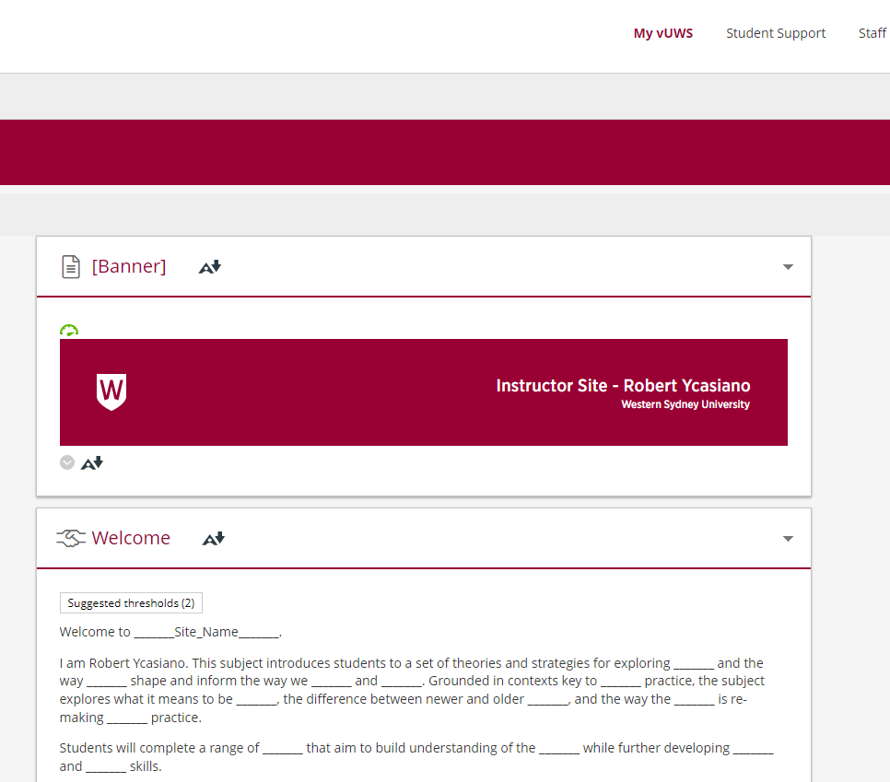
Go to Live Demo
Notes:
I will now go through a Live Demo to explain the process.

Slide 9
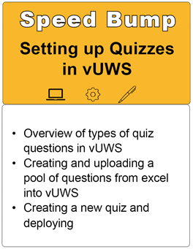
Final Pitstop!
Notes:
That about wraps it up for our Setting up Blackboard Rubrics session.
Our final pitstop within our Amazing Race theme is our Speed Bump! Setting up Quizzes in vUWS workshop which will be running tomorrow.
There’s still time left to register.

Slide 10
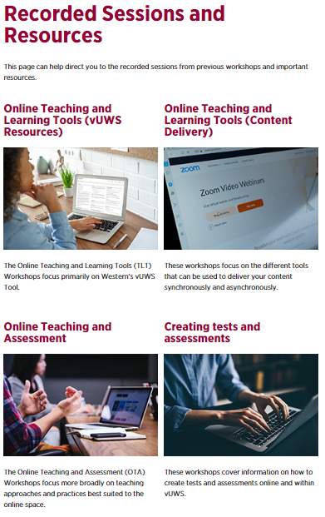
Further information
You can also find other Training Sessions on the Learning Futures Workshop Schedule website.
Self help articles (vUWS support): https://lf.westernsydney.edu.au/support/
Support - Contact us at Western Now
101 – Schedule a Booking
Digital Learning Support - Website
Notes:
You can also find other Training Sessions on the Learning Futures Workshop Schedule website.
We have Self help articles (vUWS support): https://lf.westernsydney.edu.au/support/
You can request for Support by contacting us at Western Now
You can also schedule a 101 booking with us via our Booking form
And finally, you can browse through our Digital Learning Support Website
All of the links will be provided.

Slide 11
Tell us what you think!
Did you like the workshop design and delivery?
What would you like to know more about?
It should only take 3 minutes
**We use your feedback to fine-tune, create and schedule future workshops**
Notes:
Tell us what you think!
A link is going into the chat now, any and all feedback is welcome.
We use your feedback to fine-tune, create and schedule future workshops
So please take the time to fill it in, It should only take 3 minutes

Slide 12
End
Notes:
Any questions?

