Slide 1
Preparing your Grade Centre for Mark Transfer to Banner/SMS
Presenter: Robert Ycasiano
Digital Learning Administration Officer,
Learning Futures
Notes:
Welcome everyone, thank you for attending todays workshop: Preparing your Grade Centre for Mark Transfer to Banner, my name is Robert from Learning Futures, and I will be your Digital Learning presenter for todays session.
Joining me today and monitoring the chat we have my colleagues Steph and Rhoda in the Digital Learning team.

Slide 2
ACKNOWLEDGEMENT OF COUNTRY
With respect for Aboriginal cultural protocol and out of recognition that its campuses occupy their traditional lands, Western Sydney University acknowledges the Darug, Eora, Dharawal (also referred to as Tharawal) and Wiradjuri peoples and thank them for their support of its work on their lands (Greater Western Sydney and beyond).
Notes:
I would like to begin today’s workshop by acknowledging the Traditional Custodians of the land on which we meet today, and pay my respects to their Elders past and present. I extend that respect to Aboriginal and Torres Strait Islander peoples here today.
I am joining you today from [Darug] Land. You can add in the chat which land you are joining us from.

Slide 3
Notes:
RECORDING/MUTE
Please note that this session will be recorded, please make sure your microphone is muted and disable your camera if you don’t want to be visible on the recording.
QUESTIONS
Please save your questions for the end of the workshop, although If you do have any questions, please post them in the chat and one of my colleagues will respond to you, I may leave room for questions briefly during certain intervals throughout the presentation.

Slide 4
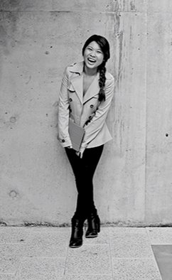
Welcome!
Today we will cover:
Column Organisation
Creating and editing different columns (beginner & advanced scenario)
Download/Upload the Grade Centre
Mapping columns to transfer marks to Banner
Where to get help
NOTE: Learning Futures does not manage RePS or Banner. This is managed by the SMS team.
Notes:
In this session we will look over the following items:
Column Organisation (which includes moving, hiding, renaming and deleting columns)
Creating and editing different columns (with beginner & advanced scenario)
Downloading and Uploading the Grade Centre
Mapping of columns in EDMM to transfer marks to Banner
Where to get help
It is important to note that this session will not include managing RePS or Banner as this is not managed by Learning Futures. There will be future sessions run by the SMS team regarding this.
There will be a RePS workshop that’s being run on the 9th of November from the SMS team, Steph if you could paste the link in the chat for everyone here if they’d like to sign up.
Now I’m going to run this workshop slightly differently, and I’m going to go straight into the live demo first. This is going to begin from an absolute beginner tutorial relating to vUWS and the Grade Centre, and will slowly work it’s way up in difficulty, I will discuss the Marks Transfer to Banner section closer to the end of the presentation.

Slide 5
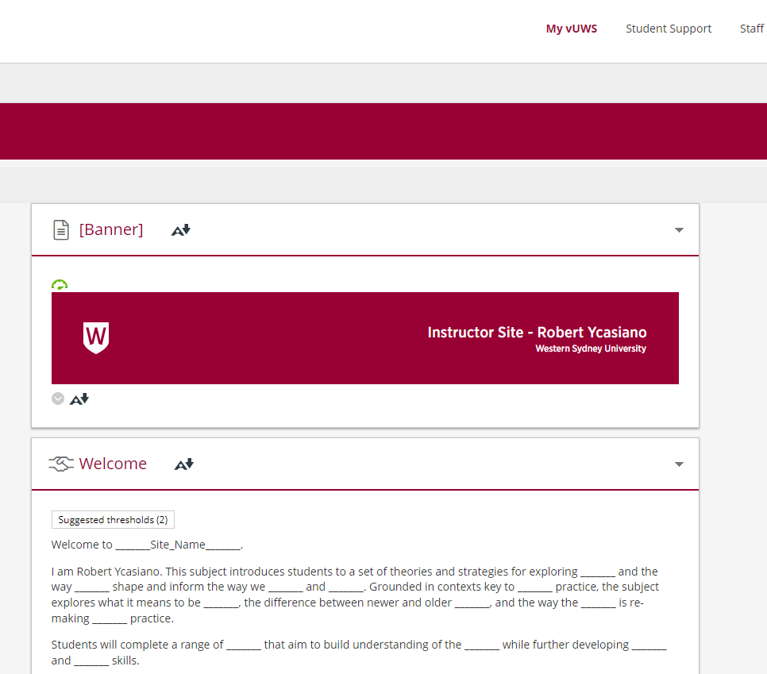
Go to Live Demo
Notes:
I will now go through a Live Demo to explain the process.

Slide 6
Calculate as Running Total: Yes
The Calculate as Running Total: Yes will ONLY include the results score in the Grade Centre and will not recognise an exam with no score as even existing. So will only add up physical results in the Grade Centre.
Notes:
The Calculate as Running Total: Yes will ONLY include the results score in the Grade Centre and will not recognise an exam with no score as even existing. So will only add up physical results in the Grade Centre.
As you can see for the student on the middle row, the scores 3 from Case Study 2 and score 2 from Case Study 6 was deducted, the non attempt for Case Study 4 was ignored and not included in the calculation, which equals a new total score of 16 with the 2 lowest attempts removed.
For the student on the bottom row, scores 3 and 3 were deducted which equals a new total score of 18 with the 2 lowest attempts removed.

Slide 7
Calculate as Running Total: No
The Calculate as Running Total: No option includes ALL columns in the calculations. Where no attempt or mark is in the Grade Centre, a value of 0 will be added.
Notes:
The Calculate as Running Total: No option includes ALL columns in the calculations. Where no attempt or mark is in the Grade Centre, a value of 0 will be added.
As you can see for the student on the middle row, the non attempt of Case Study 4, which becomes a score of 0, and the score of 2 from Case Study 6 was deducted, the non attempt for Case Study 4 was included in the calculation, which equals a new total score of 19 with the 2 lowest attempts removed.
For the student on the bottom row, scores 3 the non attempt on Case Study 6 were deducted which equals a new total score of 21 with the 2 lowest attempts removed which includes the non attempt.
Before I move on, does anyone have questions regarding this?

Slide 8
Back to Live Demo
Notes:
I will now go through a Live Demo to explain the process.

Slide 9
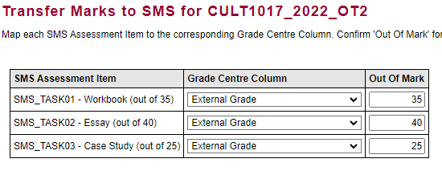
Break down of each column
Before Changes:
SMS Assessment Item is your assessment approved from your Learning Guide
Out Of is your CURRENT Out of Mark NOT your ASSESSMENT WEIGHTING
Grade Centre Column is the assessment column to be mapped in vUWS
OUT OF MARK (Raw Marks) this section needs to be updated IF the points used to mark the assessment item has changed.
Notes:
I will break down each column in the Transfer Marks to Banner section before changes
SMS Assessment Item is your assessment approved from your Learning Guide
Out Of is NOT your ASSESSMENT WEIGHTING
Grade Centre Column is the assessment column to be mapped in vUWS
OUT OF MARK (Raw Marks) this section needs to be updated if the points used to mark the assessment item has changed.
I understand that this information may be confusing to digest, so I will break down each column individually in the next slides.

Slide 10
SMS Assessment Item
The ‘SMS Assessment Item’ are the assessment items from your Learning Guide that have been approved by your SAC. This data has been pulled directly over from Banner to EDMM.
The (out of) mark next to the Assessment Item is the full mark that the assessment is currently marked out of in vUWS.
NOTE: the total of these 3 assessments DO NOT need to equal 100 as it is not an overall weighting.
Notes:
The ‘SMS Assessment Item’ are the assessment items from your Learning Guide that have been approved by your SAC (School Academic Committee). This data has been pulled directly over from Banner to EDMM.
The (out of) mark next to the Assessment Item is the full mark that the assessment is currently marked out of in vUWS and was pulled from Banner.
Do note that the total of these 3 assessments DO NOT need to equal 100 as it is not an overall weighting.

Slide 11
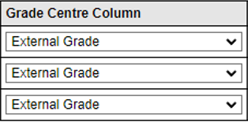
Grade Centre Column
The Grade Centre Column will be the column in your Grade Centre that contains the raw marks for that particular assessment. This will the column chosen to be mapped and will be transferred to Banner to be used as the final result.
Before Changes
After Changes
Notes:
The Grade Centre Column will be the specific column in your Grade Centre that contains the grades for all student submissions for that particular assessment. This will the column chosen to be mapped and will be transferred to Banner to be used as the final result.
As you can see here we have a before and after column, the left column is the default option before any changes are made, and the right column will be the updated options after allocating the specific Grade Centre column to be mapped to Banner. I will walk through this process during the live demo.

Slide 12
Grade Centre Column
The Grade Centre Column will be the specific column in your Grade Centre that contains the grades for all student submissions for that particular assessment. This will the column chosen to be mapped and will be transferred to Banner to be used as the final result.
Notes:
On this next slide, these are the specific columns within Grade Centre that contains the grades for all student submission attempts for that particular assessment. This will be the column chosen to be mapped and will be transferred to Banner or RePS to be used as the final result overall.
See how the names are matching exactly and using the naming convention. This is why it’s important to have a naming convention so that it is much easier to identify the specific column you want to map.

Slide 13
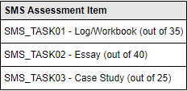
Out of Mark
The ‘Out of’ mark under the SMS Assessment Item column on the left side needs to be MATCHING the Grade Centre column in vUWS. If the ‘Out of’ column and Grade Centre column DO NOT MATCH, enter the new score under the ‘Out of Mark’ column on the right side.
Notes:
The ‘Out of’ mark under the SMS Assessment Item column on the left side needs to be MATCHING the Grade Centre column in vUWS. If the ‘Out of’ column and Grade Centre column DO NOT MATCH, enter the new score under the ‘Out of Mark’ column on the right side.
The info for the ‘Out of’ was either gathered from the Data Clean Up form, or rolled over from a previous teaching session.
In this example with Assessment Item 2 – the out of mark is currently set to be marked out of 40 but in vUWS, the Essay is marked out of 100 points. This is where you will need to change the Out of Mark for Assessment 2 from 40 to 100 as referenced in the previous slide.
The other 2 columns for the other assessments can remain the same and do not need to be changed as Assessment 1 will be marked out of 35 in vUWS, and Assessment 3 will be marked out of 25 points in vUWS.

Slide 14
After Changes
Grade Centre Columns have been mapped to the relevant columns from the Grade Centre.
Assessment 2 ‘Out of Mark’ has been updated from 40 to 100.
Notes:
Grade Centre Column has been updated to the relevant column in Grade Centre
Assessment 2 ‘Out of Mark’ has been updated from 40 to 100
The grading scale for each Assessment type should be correctly set up in Data Clean Up (DCU), but can be edited to suit your grading scale when mapping in EDMM.
If you are making a change, this alteration will only affect this semester’s grading and will not change the default, so when you roll over your vUWS site to a new semester, you’ll need to edit the grading scale again.
If this is the grading scale you will be using each semester, you’ll need to submit a ticket to WesternNow or contact the SMS team to have the grading scale permanently altered.
You do not need to create any weighted columns within the Grade Centre as Banner will calculate this for you.
After your changes have been updated, select Confirm Mapping

Slide 15
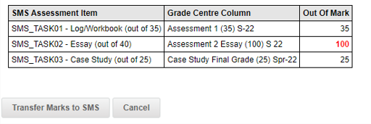
Submitting Results
After selecting Confirm Mapping. EDMM will take you to the next page to display the updated changes. Once confirmed that the correct Grade Centre Column, and Out of Mark are selected, click on Transfer Marks to SMS.
Notes:
After selecting Confirm Mapping. EDMM will take you to the next page to show the updated changes. Once confirmed that the correct Grade Centre Column, and Out of Mark are selected, click on Transfer Marks to SMS.
If you receive an error message, could be an issue with the transfer at that time, or could be that there’s a duplication of Grade Centre Columns chosen, you will receive an error message, and you should receive the error message emailed to you. If you do receive the email and need assistance, contact ITDS and they will investigate your issue.

Slide 16
Back to Live Demo
Notes:
I will now go through a Live Demo to explain the process.

Slide 17
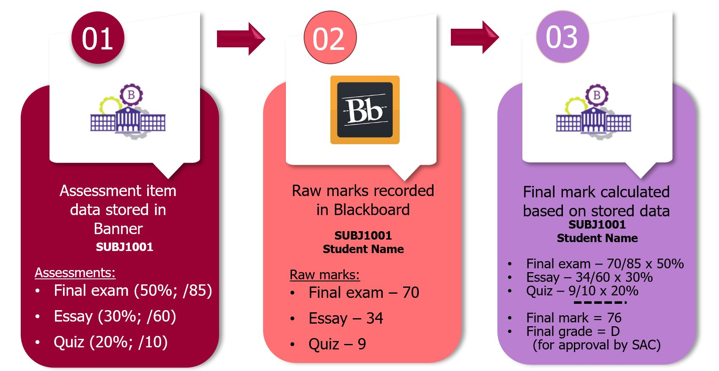
Assessment Item Data Flow
Notes:
Lets go through a quick overview of the Assessment Item Data Flow that will occur.
The first part of the process is the Assessment item data stored in Banner, which was pulled from your subject approved assessments in your Learning Guide.
In Image Number 1 we see:
The final exam weighted is out of 50%, but the grading scale is out of 85 marks
The essay exam weighted is out of 30%, but the grading scale is out of 60 marks
The quiz exam weighted is out of 20%, but the grading scale is out of 10 marks
In Image Number 2, this represents the student receiving a result in the Grade Centre
For the Final exam they received a grade of 70 marks
For the Essay they received a grade of 34 marks
For the Quiz they received a grade of 9 marks
These are the marks that will be transferred to Banner. You do NOT do the weighting calculation in the Grade Centre.
Image Number 3 is the final stage where Banner gets the Final exam grading of 70 marks and divides that by 85 being the grading scale and then multiplies that by the Assessment weighting of 50 to get a score of 41.18. This will round down to 41.
Banner will do the same calculation for the Essay getting a result of 17, and for the Quiz, a result of 18, which is 76.18 rounded down to 76 as the final grade for the Subject.
I hope this overview has given you an understanding of the process. I will now demonstrate in vUWS and run through setting up your Grade Centre.
In this demonstration, the vUWS dashboard will look slightly different as this is in the Staging environment which will be released to everyone soon. The layout of your subject sites will look exactly the same.

Slide 18
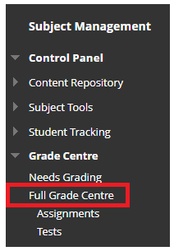
Grade Centre
Navigating the Grade Centre
Accessing the Grade Centre:
Log in to vUWS
Go to your vUWS site
Ensure Edit Mode is ON
On the left menu, click to expand Grade Centre
Click on Full Grade Centre
Notes:
Accessing the Grade Centre:
Log in to vUWS
Go to your vUWS site
Ensure Edit Mode is ON
On the left menu, click to expand Grade Centre
Click on Full Grade Centre

Slide 19
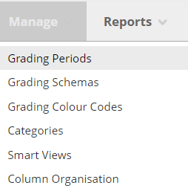
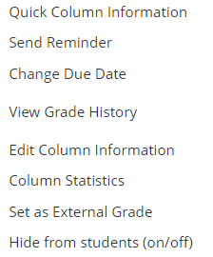
Column Management
Move / Hide Columns
Notes:
MOVE:
To move the order of your columns around, hover over Manage > Column Organisation > click and hold 4 arrows and drag > submit
OR
Hover over Manage > Column Organisation > click on up and down arrows on right hand side > pop up and move up or down > apply > submit
HIDE:
To hide columns all together meaning from instructor and students, you will first need to hide the column on the main full grade centre page, you will see a red cancel icon appear.
Then hover over Manage > Column organisation > *hidden in grey* > tick the box/s you wish to hide > scroll down and click hide column > submit. *show that column is hidden*
DELETE:
Note: Once a column has been deleted, it cannot be retrieved, so it is recommend that before you delete a column you ensure a copy of the Grade Centre is downloaded.

Slide 20
Column Management
Change column name
Notes:
Use a unique name so that it makes mapping the columns in EDMM easier.
Such as Assessment 1 Spr22 (35)
The assessments name
Session and year
Out of total – what the assessment has been marked out of
Giving the name a unique title will assist you when cleaning up your columns at the start of each session and also easier to map in EDMM
BB - You will need to change the name in the assessment itself, not the column in GC.
Turnitin – for the name to pick up in GC you will need to ensure the name is updated in Turnitin.

Slide 21
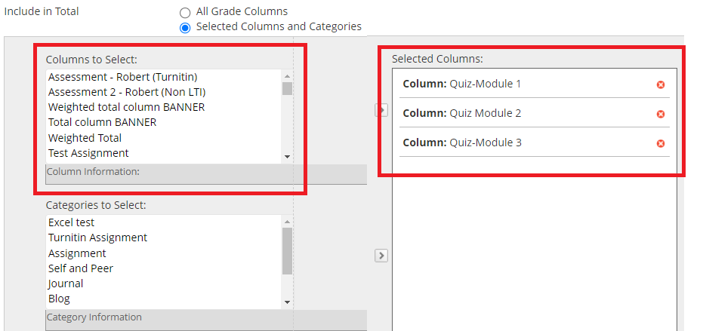
Column Management
Creating Calculated Columns
Notes:
Calculated total column
Create category:
Create a unique category
Click the Manage tab above the column listing.
Click Categories from the drop-down list.
Click the Create Category button at the top.
Name: The name should be unique. For example: Assess 2: Quiz Pool (For the purpose of these instructions, we’ll assume the name above was used)
Click Submit.
Click OK.
Assign each quiz/test to this unique Category
Click the drop-down arrow beside the first quiz column name.
Click Edit Column Information.
Set Category to Assess 2: Quiz Pool.
Click Submit.
Repeat until all quizzes have the new category applied.

Slide 22
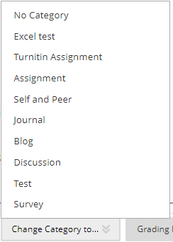
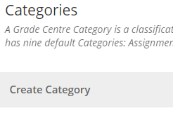
Column Management
Create Category
Notes:
Create category:
Create a unique category
Click the Manage tab above the column listing.
Click Categories from the drop-down list.
Click the Create Category button at the top.
Name: The name should be unique. For example: Assess 2: Quiz Pool (For the purpose of these instructions, we’ll assume the name above was used)
Click Submit.
Click OK.
Assign each quiz/test to this unique Category
Click the drop-down arrow beside the first quiz column name.
Click Edit Column Information.
Set Category to Assess 2: Quiz Pool.
Click Submit.
Repeat until all quizzes have the new category applied.
Best of column

Slide 23
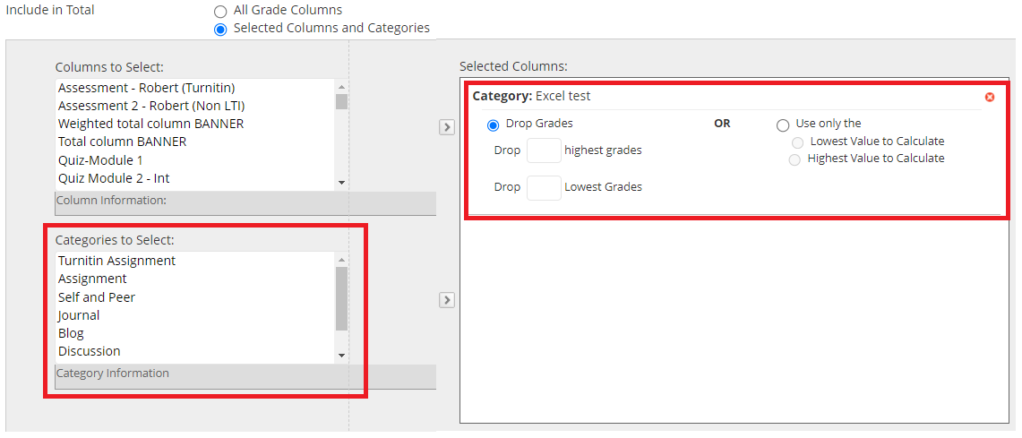
Column Management
Best of Column
Notes:
Best of column / Create a subtotal column and add the unique Category
Click the Create Calculated Column button at the top.
Click Total Column.
Columns Name: enter Subtotal - Best quiz results.
Primary Display: Score.
Under the SELECT COLUMNS section in Include in Total, select Selected Columns and Categories.
In the Categories to select: panel choose Assess 2: Quiz Pool.
Click the right facing arrow to add this category to the Selected Columns panel.
Select Drop Grades.
Drop: enter 4 beside Lowest Grades.
Scroll down and set Calculate as running total: No.
Calculate as a Running Total
A Running Total calculates the total by including only the Grade Columns that have been graded. Selecting No for this option includes all Columns in the calculations, using zero (0) for Columns that have not been graded. This can make grades appear artificially low.

Slide 24
Download the Grade Centre
From the Full Grade Centre page
Click Work Offline then Download
Leave all default options selected and click Submit
The Grade Centre data will be saved to a file. Click Download to save a copy
Notes:
Log in to vUWS.
Go to your vUWS site.
Ensure Edit Mode is ON.
In the left menu, under Subject Management, go to the Grade Centre > Full Grade Centre.
Click Work Offline > Download.
Leave all default options selected and click Submit.
The Grade Centre data will be saved to a file. Click Download to save a copy.
You can then edit, grade in the excel before bringing this back into vUWS.

Slide 25
Upload the Grade Centre
From the Full Grade Centre page
Click Work Offline then Upload
Leave all default options selected and click Submit
The Grade Centre data will be saved to a file. Click Download to save a copy
Notes:
Log in to vUWS.
Go to your vUWS site.
Ensure Edit Mode is ON.
In the left menu, under Subject Management, go to the Grade Centre > Full Grade Centre.
Click Work Offline > Upload
Leave all default options selected
You will see a page where it indicates the columns you have made changes to
Click submit
A green text box will appear at the top of the page

Slide 26
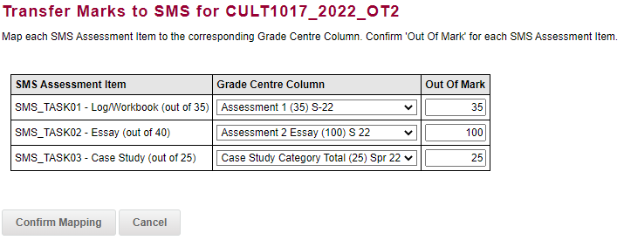
Transfer Columns
If you experience an issue transferring Grade Centre marks to Banner, you will need to submit a ticket to ITDS.
Notes:
Now that all of our Assessment columns have been created, we now need to navigate to EDMM to Transfer the marks to SMS.
******* If there’s an issue with the Grade Centre Marks Transfer goes wrong, need to submit ticket to ITDS -
https://wsu.service-now.com/staff?id=sc_cat_item&sys_id=1d6b07541bc01910c469c91a274bcb70

Slide 27
Further information
You can also find other Training Sessions on the Learning Futures Workshop Schedule website.
Self help articles (vUWS support): https://lf.westernsydney.edu.au/support/
Support - Contact us at Western Now
101 – Schedule a Booking
Digital Learning Support - Website
Notes:
You can also find other Training Sessions on the Learning Futures Workshop Schedule website.
We have Self help articles (vUWS support): https://lf.westernsydney.edu.au/support/
You can request for Support by contacting us at Western Now
You can also schedule a 101 booking with us via our Booking form
******* If GC transfer goes wrong, need to submit ticket to IT/SAS-
https://wsu.service-now.com/staff?id=sc_cat_item&sys_id=1d6b07541bc01910c469c91a274bcb70

Slide 28
Tell us what you think!
Did you like the workshop design and delivery?
What would you like to know more about?
It should only take 3 minutes
**We use your feedback to fine-tune, create and schedule future workshops**
Notes:
Tell us what you think!
A link is going into the chat now, any and all feedback is welcome.
We use your feedback to fine-tune, create and schedule future workshops
So please take the time to fill it in, It should only take 3 minutes

Slide 29
End
Notes:
Any questions?

