Slide 1
Learning Futures
Marking Quiz Questions
THIS SESSION IS BEING RECORDED.
Please Make Sure Your Microphones Are Muted.

Slide 2
Welcome!
This session will provide an overview of how to mark short answer and essay answer questions in vUWS
See or Hide Student Names While Marking
Mark By Question
View All Attempts

Slide 3
Housekeeping

Slide 4
Housekeeping
This workshop will be recorded. If you do not want to be recorded
Turn off your camera
Use the chat function instead of verbal question
Mute your microphone when not speaking

Slide 5
What happens if the connection drops out?
Recorded sessions and recourses available on our webpage
Notes:
https://bit.ly/2Sk7Pmh

Slide 6
What do Students see?

Slide 7
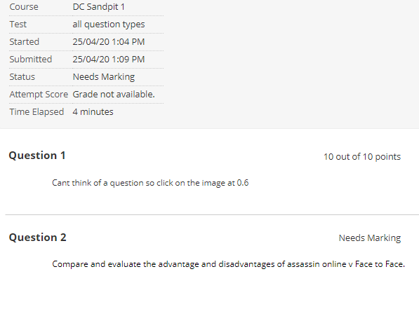
Notes:
Once they have submitted their quiz they will see this summary.

Slide 8
Locating your Quiz/Test

Slide 9
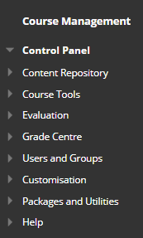
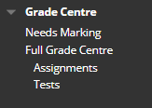
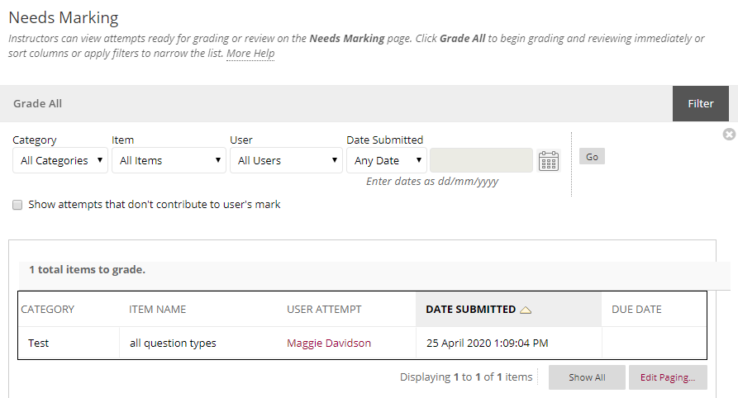
Notes:
FD

Slide 10
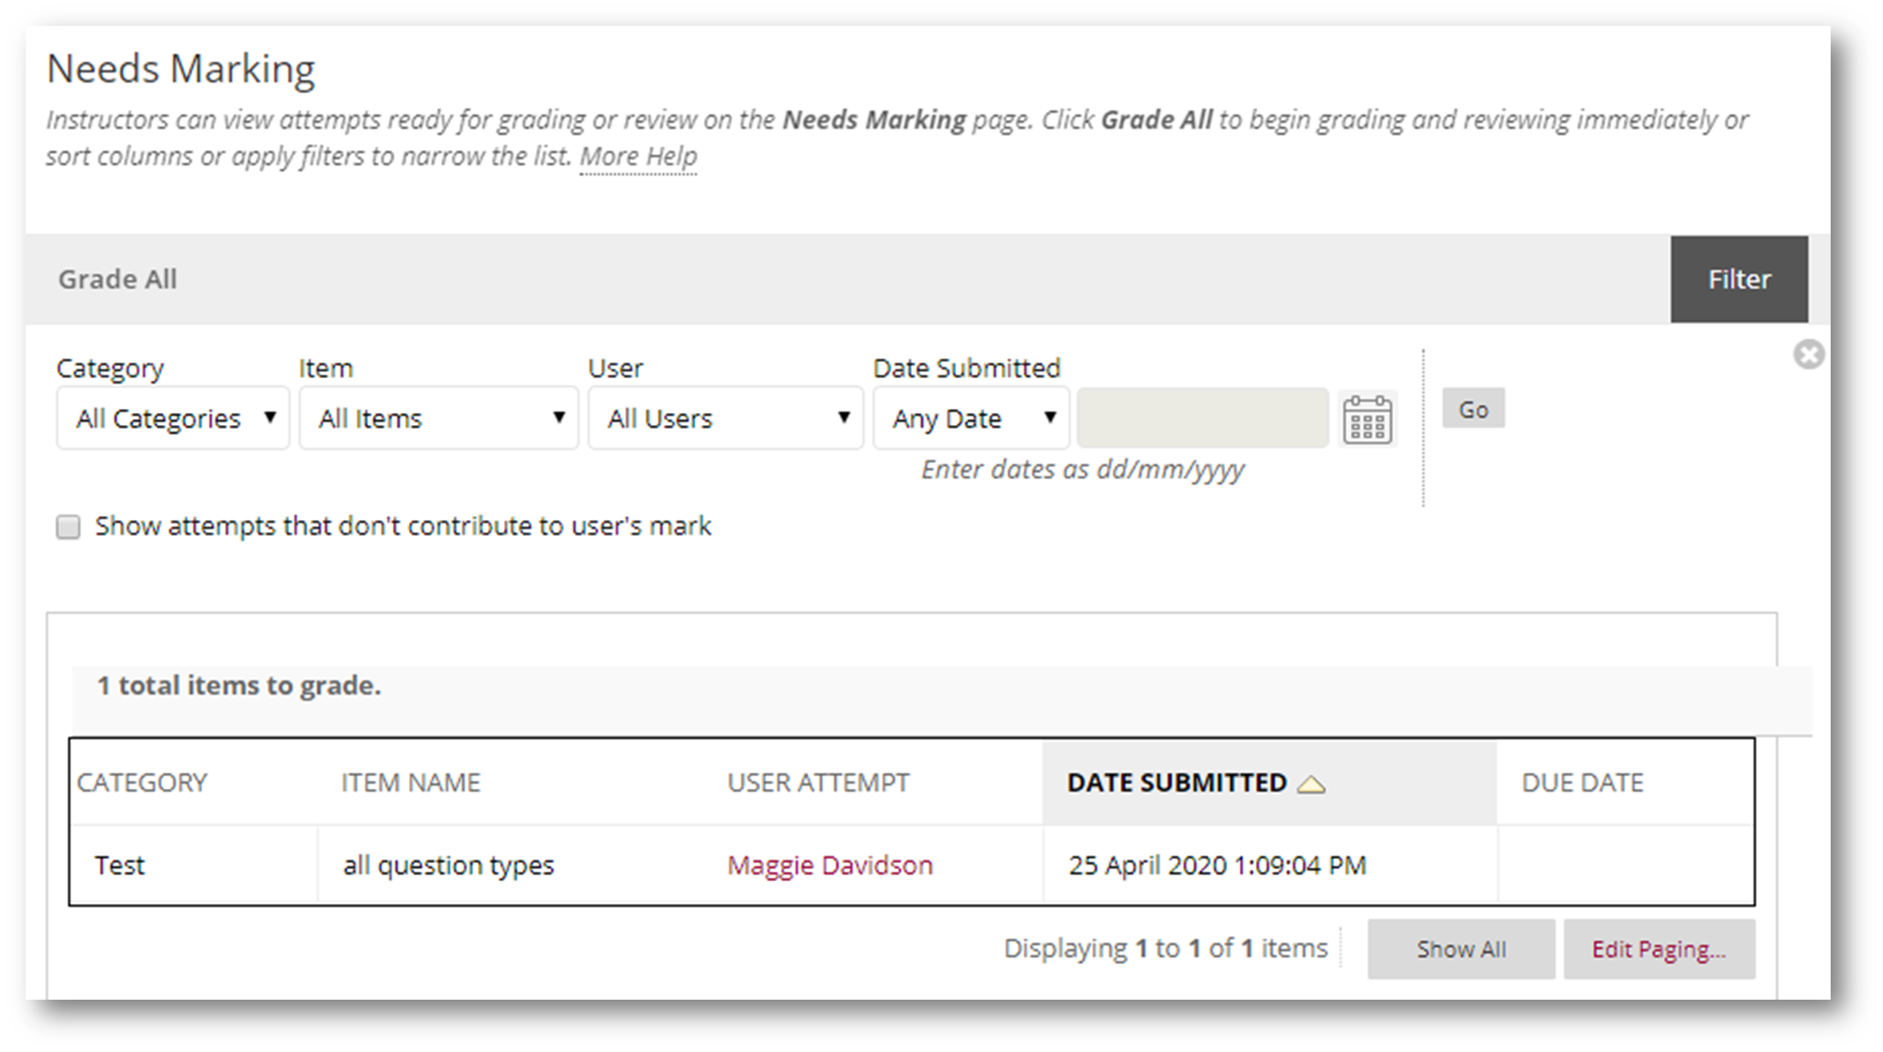
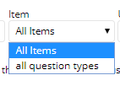
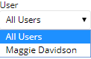
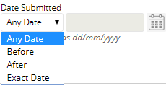

Slide 11
Marking Options
See or Hide Student Names While Marking
Mark By Question
View All Attempts

Slide 12
Marking Options
See or Hide Student Names While Marking.

Slide 14
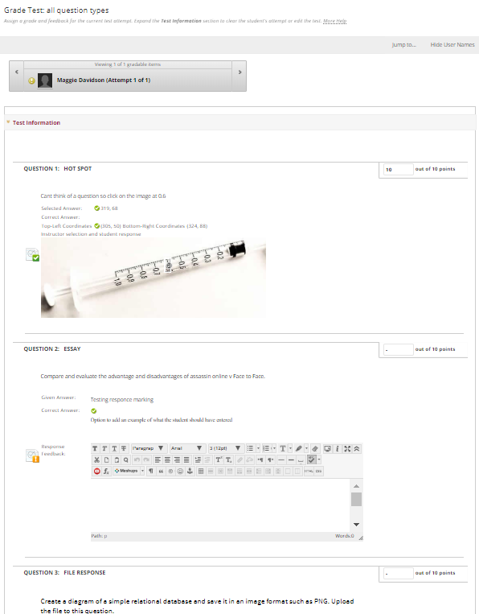
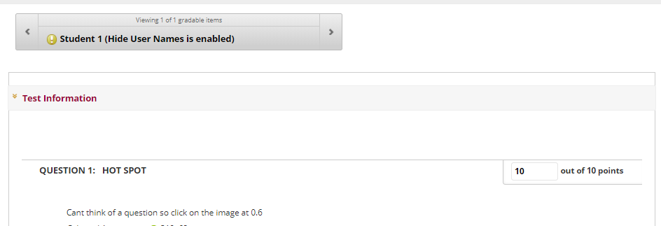
GRADE ALL USERS
GRADE WITH USERNAMES HIDDEN

Slide 15
To show user names,
select ‘Show User Names’

Slide 16
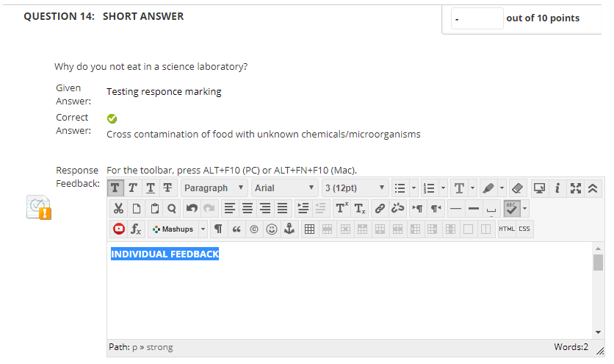
Add Mark
Review answer
Optional
Submit when complete
Notes:
-

Slide 17
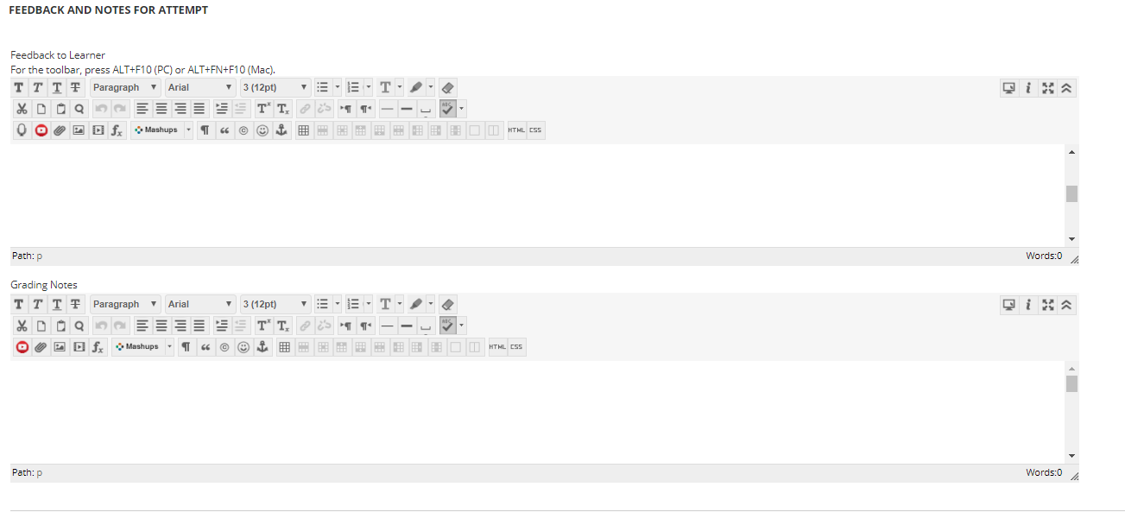

Slide 18
Marking Options
2. Marking by Question

Slide 19
Notes:
FD

Slide 20
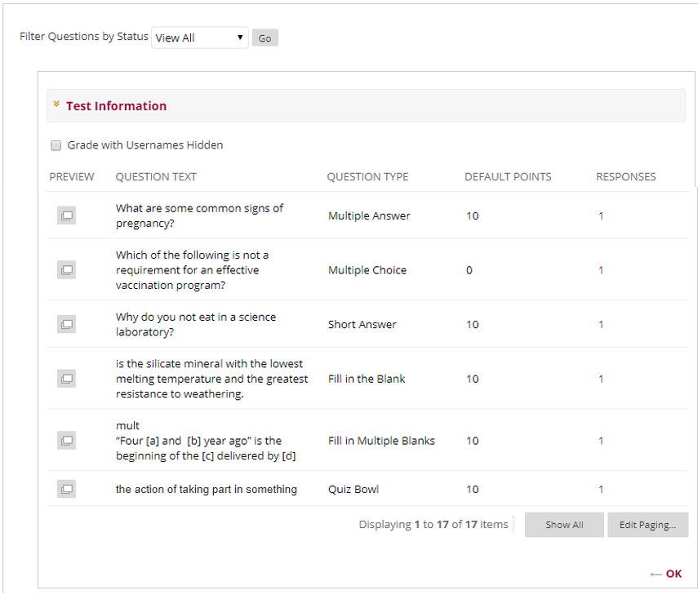
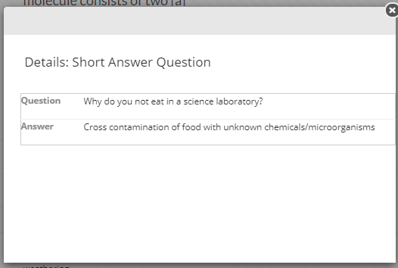
Click to access attempts
GRADE BY QUESTION

Slide 21
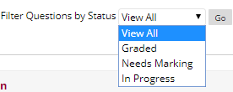

Slide 22
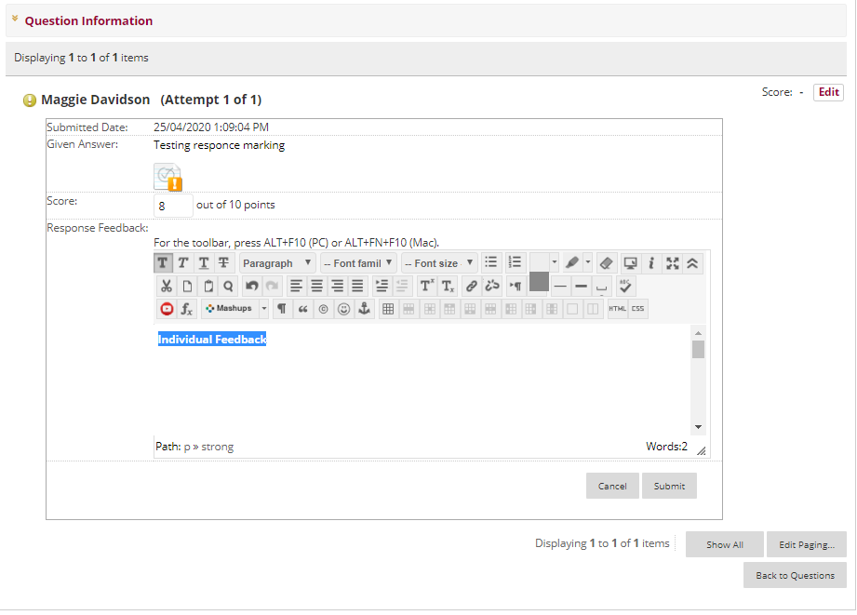
Review answer
Add Mark
Optional

Slide 23
Marking Options
3. View Student Attempts

Slide 24
Notes:
FD

Slide 25
VIEW ALL ATTEMPTS

Slide 26
Add Mark
Review answer
Optional
Submit when complete

Slide 27
Additional Resources:

Slide 28
Further information
Information and resources:
Learning Futures Online Workshops.
For any self help articles: https://dft.westernsydney.edu.au/support/
List of: List of all training sessions
Email us at: elearning@westernsydney.edu.au

Slide 29
Notes:
Thank you for your time

