Slide 1
Writing questions for online exams
This workshop will be recorded
If you do not wish to be recorded please turn off your video

Slide 2
Zooming considerations
Mute your microphone when not speaking.
Change your staff number to your name.
Turn off video if there are sound and/or delay issues.
Raise your hand to ask a question (click on Participants to access)
The session will be recorded. Please turn off video and ask questions via chat if you prefer not to be.
The recorded session will be available 1 week later.
⊗ If the session drops out, the session will be recorded and made available afterwards
Lynn

Slide 3
Outline of the workshop
Content
Steps for going online
Aligning learning outcomes using a matrix
Question types in vUWS
Quizzing for deeper learning
Examples of re-writing questions
Discussion & Questions
Resources
A checklist

Slide 4
Writing questions for your online exam: Steps to consider
1. Identify the levels of learning (what key learning outcomes need to be addressed?)
2. Use words at the appropriate level in Blooms Taxonomy or similar to write your question stem/phrase questions
3. Check that the learning material supports students in answering the questions
4. Clearly identify the purpose of the assessment along with clear criteria for success, sample responses
5. Consider the number of questions and the time allowed to complete the exam
6. For open book exams, consider providing a resource collection from which students find what they need to answer the questions.
7. Write questions that address higher levels of learning, analyse, evaluate, synthesize knowledge, critical thinking.
8. Avoid questions with only one correct answer by requiring students to catalogue, critique, plan, justify, reflect, etc. This helps avoid plagiarism.

Slide 5
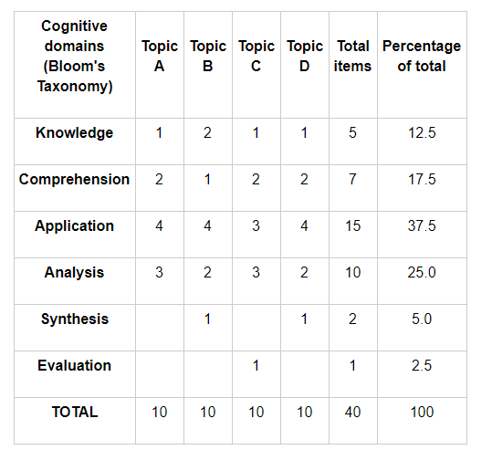
Consider this strategy for designing a quiz to ensure coverage of content and alignment with levels of learning
Group content (e.g. Topic A-D)
List the levels of learning (knowledge – evaluation)
Determine the number of questions for each Topic and align these with the levels of learning. For example, in the Knowledge row there are 5 questions aligned to each topic area.
The table indicates that the emphasis is more on application and analysis.
Using the table, you can design quizzes with different levels of difficulty.
Source: Assessing by multiple choice questions, https://teaching.unsw.edu.au/assessing-multiple-choice-questions
Notes:
In designing questions it is worthwhile asking HOW questions are being asked and if a range of levels of thinking is required.

Slide 6
Example learning outcomes that align with quizzes/exams
The kinds of learning that can be demonstrated will typically range from lower order thinking (remember, understand) to mid order (apply)(from revised Blooms taxonomy). In the matrix below the learning outcomes are aligned with the key content of the unit and with levels of learning. The matrix is also a way to balance questions across the content.
Notes:
There is a range of learning demonstrated in the matrix. What range of learning will your unit require? Recall, apply, integrate?

Slide 7
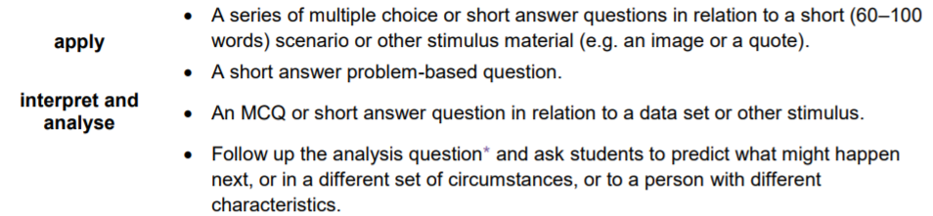

Slide 8
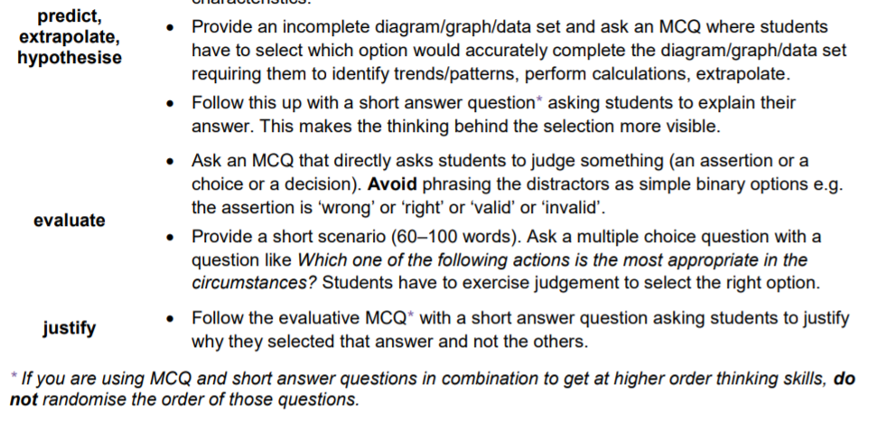
Examples from ITALI UQ

Slide 9
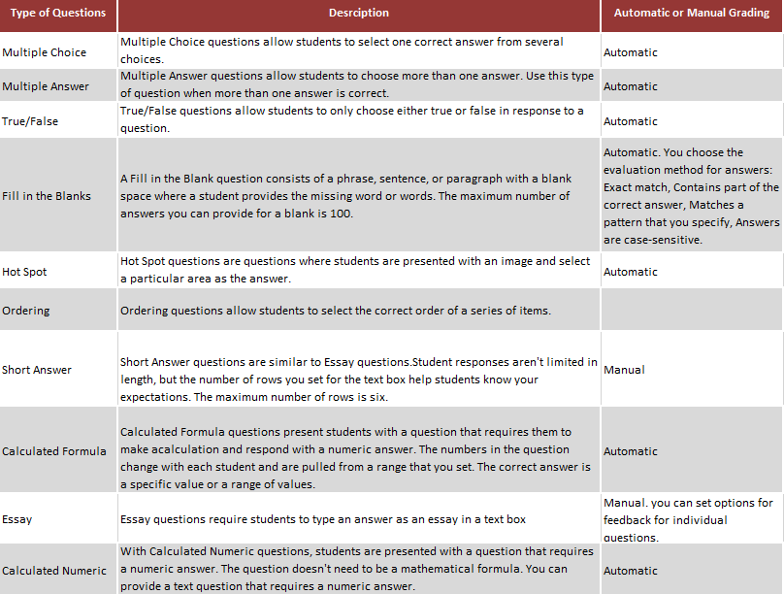
Some question types in vUWs. Some question types are associated with high probability of guessing, eg MCQ, True/false.
Some question types are associated with input errors, for example ‘Fill in the blanks’ answers may be marked wrong if spelling is incorrect.
Recommended are questions that have more than one correct answer, such as Multiple Answer, Short and Essay questions; or those that
generate different questions through a formula, Calculated Formula.

Slide 10
What settings are important to consider?
Randomise questions
Randomise answers (MCQ)
Question pools
Timer
Rubric for Short Answer
Feedback for questions (typical for alternative assessment, less so for final assessment)
Return grades instantly or hold for set date?

Slide 11
What general tips should I consider?
Ensure instructions assist students to minimise technical issues (wi-fi, Netflix, etc), and have a support pathway (IT) were technical issues to occur.
To reduce likelihood of student issues, host one or more practice or formative quizzes ahead of time. Mimic the final exam format.
To increase academic integrity, create pools of equivalent questions, randomly presented to students.
If creating a lot of quizzes, or lots of question banks, explore the use of Respondus 4.
To reduce student bandwidth requirements, limit question attachments to a web-optimised standard.
Images – Photoshop – Save for Web – JPEG High Quality.
Video / Audio – Upload to Panopto for processing and sharing via embed code. Consider Handbrake.
If questions and/or answers are randomised, avoid linked questions/answers “eg. the previous question stated X” or “all of the above”

Slide 12
Quizzing for deeper learning
Design quizzes to enhance learning and discourage guessing.
Consider multi answer with 3-5 options with 2-5 options correct
Deduct marks for incorrect answers (this discourages guessing but use with caution)
Give partial credit for correct multi answers
Allow for 2nd or 3rd attempts with marks deducted for each attempt (also discourages guessing)
Create scenario-based MCQ to test analysis, evaluation & identification skills
Review student responses to discover where learning needs to be reinforced (learning analytics) & to identify errors in questions*
Tip: Raise the pass threshold, eg 75%
Notes:
*Review quiz questions and student performance through Item Analysis and Download Results. See these options via Grade Centre > Tests > Name of quiz. In Grade Centre, click on the down arrow for the above options. Results can be downloaded into a word document (keep default encoding) and then copied into Excel. See University of Melbourne instructions and information on Item Analysis https://lms.unimelb.edu.au/support/guides/blackboard-staff-guides/item-analysis

Slide 13
Quizzing for deeper learning: modify MCQs
Identify questions that ask what/when/who/which/where is X OR are factual statements | Modify the question stem | OR change to a short answer question
Example: 1. What is the strongest & most resilient X? 2. The strongest & most resilient X is: (factual statement) | Why is X… | Explain how X ….& provide an example
 | How is X…/to what extent is | Explain the difference between…
 | Select the most appropriate explanation for X | How does X function.. provide an example to illustrate your explanation
 | Using the information in the graph & under these conditions…, what kind of X is this?
 | Which finding is the most relevant given the conditions described?
Notes:
*Review quiz questions and student performance through Item Analysis and Download Results. See these options via Grade Centre > Tests > Name of quiz. In Grade Centre, click on the down arrow for the above options. Results can be downloaded into a word document (keep default encoding) and then copied into Excel. See University of Melbourne instructions and information on Item Analysis https://lms.unimelb.edu.au/support/guides/blackboard-staff-guides/item-analysis

Slide 14
Quizzing for deeper learning: write for higher levels of thinking
For short answer & essay questions ask students to clarify, explain assumptions, provide reasons and evidence, identify the source of an opinion, to consider implications and consequences, to hypothesize with reasonings, to provide different points of view, and to provide alternative solutions indicating which is preferred and why.
Level | Question
Analyse | Predict how the Y difference between A and B will change if X is increased. Explain your prediction. Compare your solution procedure to this problem to how you would solve problems X and Y. Find and describe a common solution procedure for these problems.
Evaluate | Assess the effects of X on this problem - how would X effect this problem?
Create | Invent and describe a practical use for the device shown. Create your own X problem involving Y in Z. Compose a 'solution manual' version of your solution, such that a student with little knowledge of the equation could understand your solution.
Notes:
*Review quiz questions and student performance through Item Analysis and Download Results. See these options via Grade Centre > Tests > Name of quiz. In Grade Centre, click on the down arrow for the above options. Results can be downloaded into a word document (keep default encoding) and then copied into Excel. See University of Melbourne instructions and information on Item Analysis https://lms.unimelb.edu.au/support/guides/blackboard-staff-guides/item-analysis

Slide 15
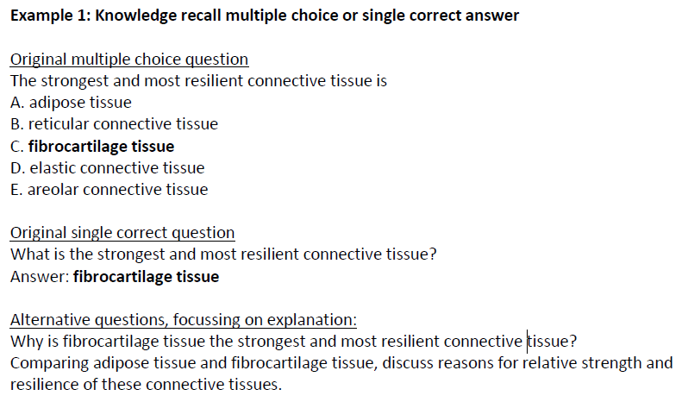
Redesign quiz questions from recall to application of knowledge – example 1
Examples from Centre for Research in Assessment and Digital Learning. (n.d.). Ensuring academic integrity and assessment security with redesigned online delivery, Deakin University.

Slide 16
Redesign quiz questions – example 2(a)

Slide 17
Redesign quiz questions – example 2(b)

Slide 18
Resources
Costello, E., Holland, J., & Kirwan, C. (2018). The future of online testing and assessment: question quality in MOOCs. International Journal of Educational Technology in Higher Education 15(42). https://doi.org/10.1186/s41239-018-0124-z
Tips ondesigning MCQs
Jeremy B. Williams and Amy Wong, ‘The efficacy of final examinations: A comparative study of closed-book, invigilated exams and open-book, open-web exams’, British Journal of Educational Technology, 40(2), 2009, pp. 227-36.
For Curriculum design – starting with the end in mind see: Angelo, T. (2012). Designing subjects for learning: practical research-based principles and guidelines. In L.Hunt & D.Chalmers (Eds) University teaching in focus, ACER Press.

